Slide 1
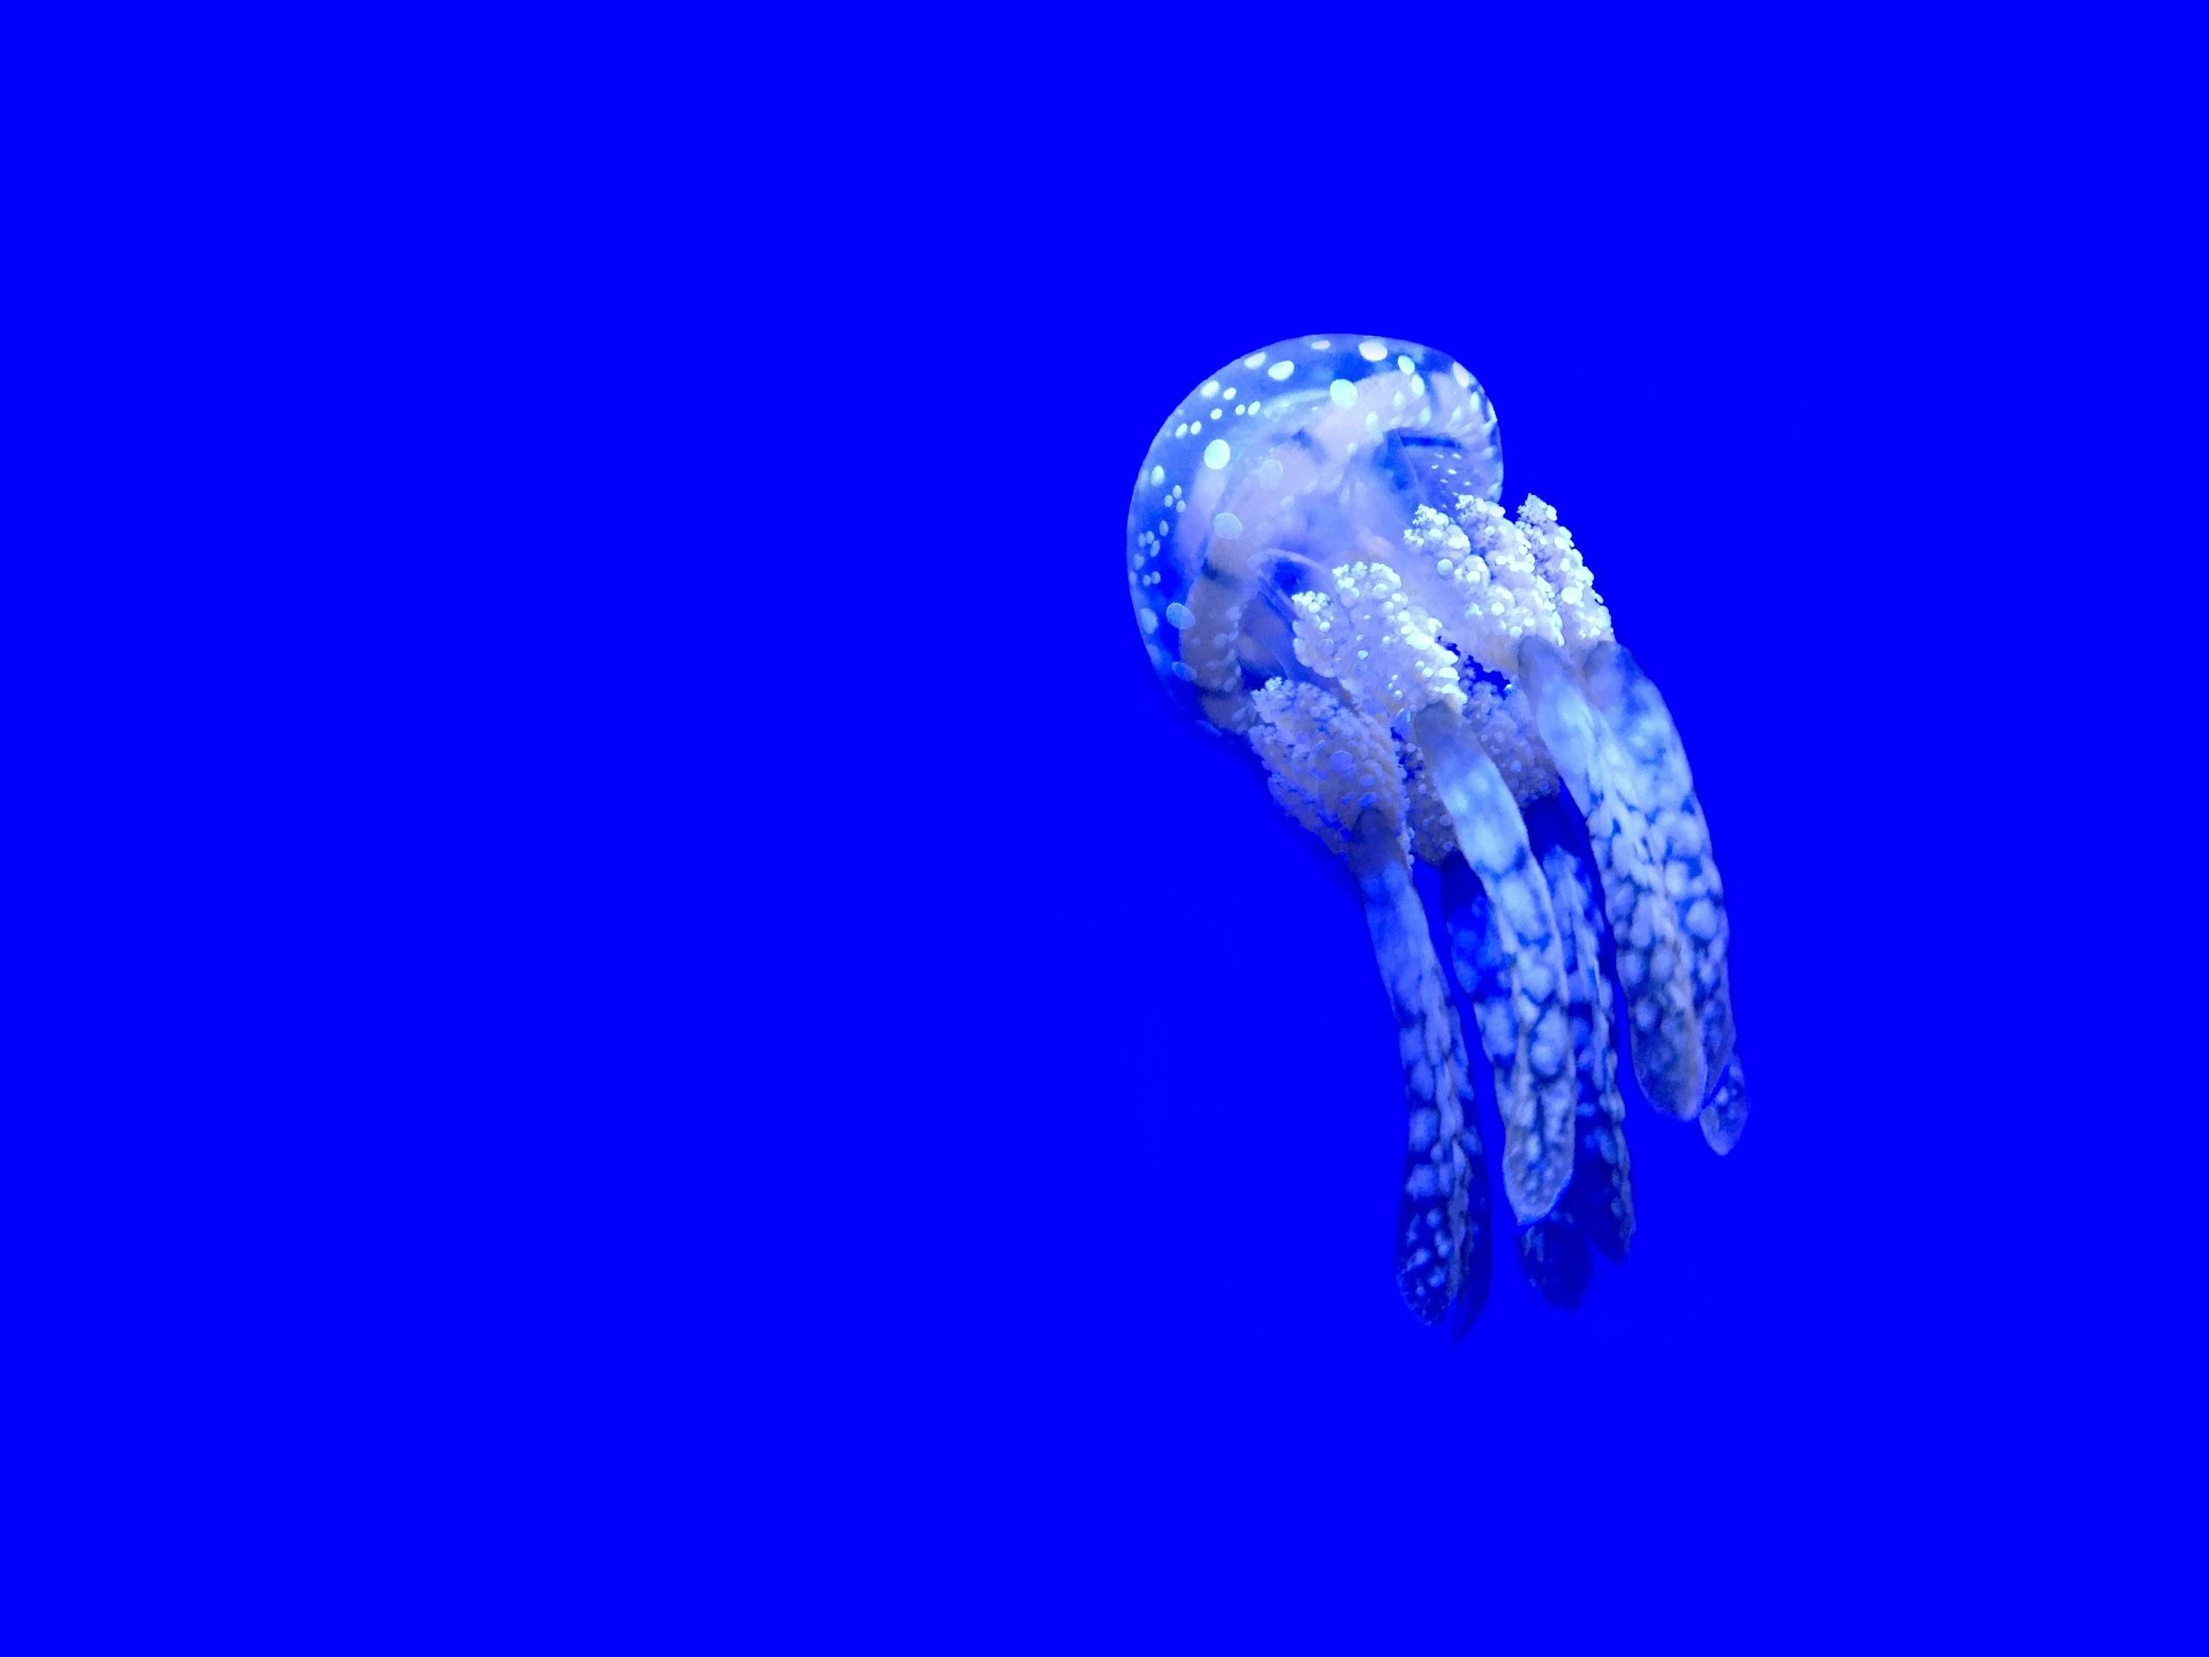
Kinyarwanda Voice-Interaction Hackathon: Common Voice

Slide 2
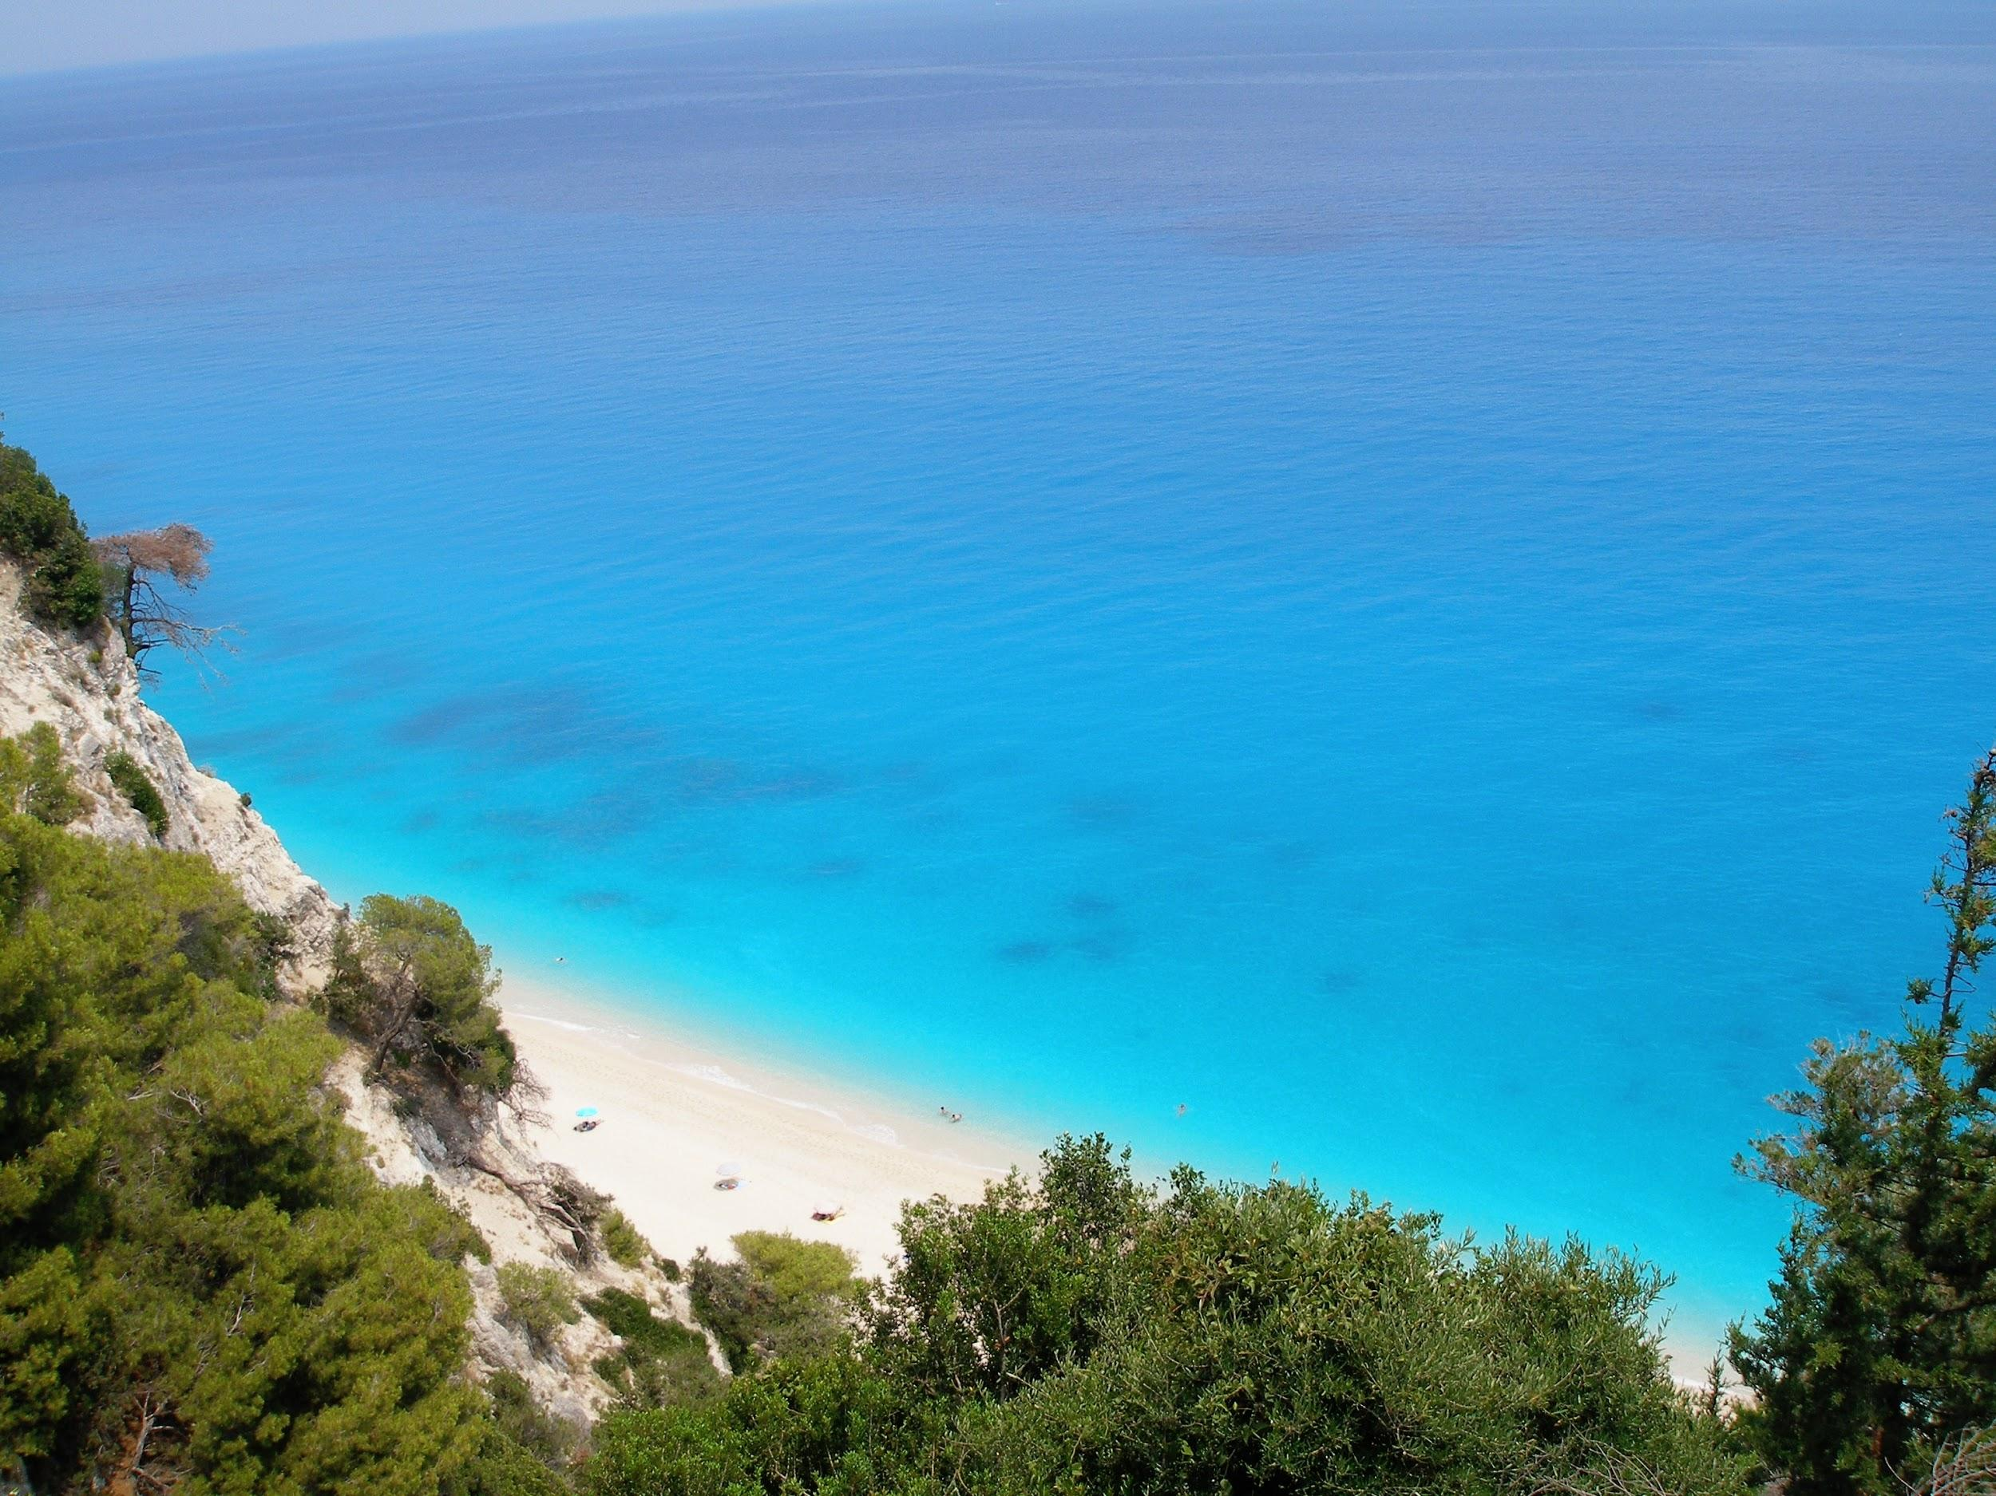
Outline
1 Intro
2 Speech Corpora
3 Common Voice
4 Future of Common Voice

Slide 3
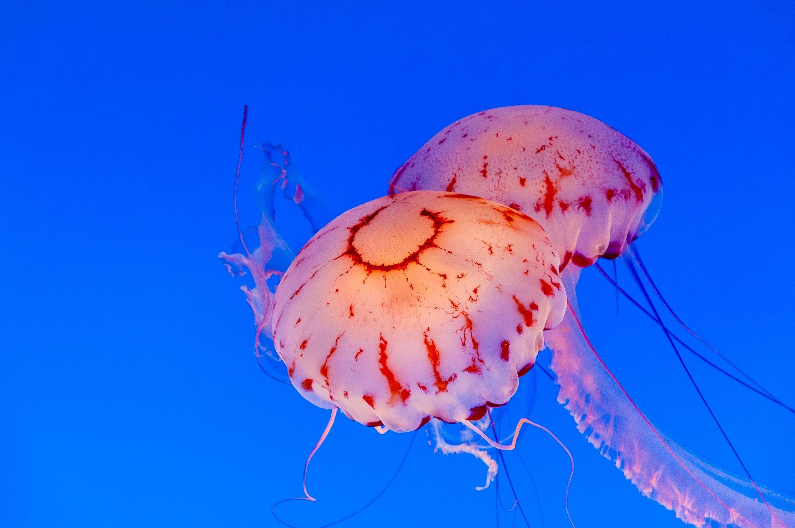
1 Intro

Slide 4

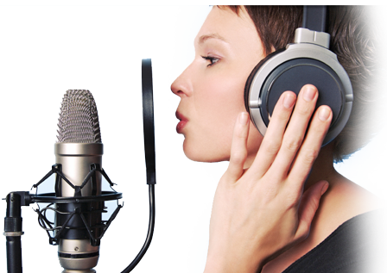
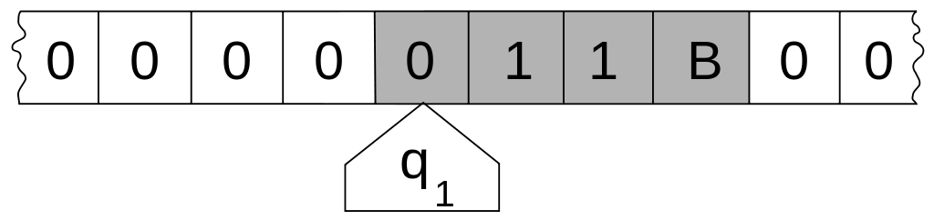
Intro: Speech-to-Text
"Mr. Watson, come here. I want to see you."
Speech
Computation
Text

Slide 5
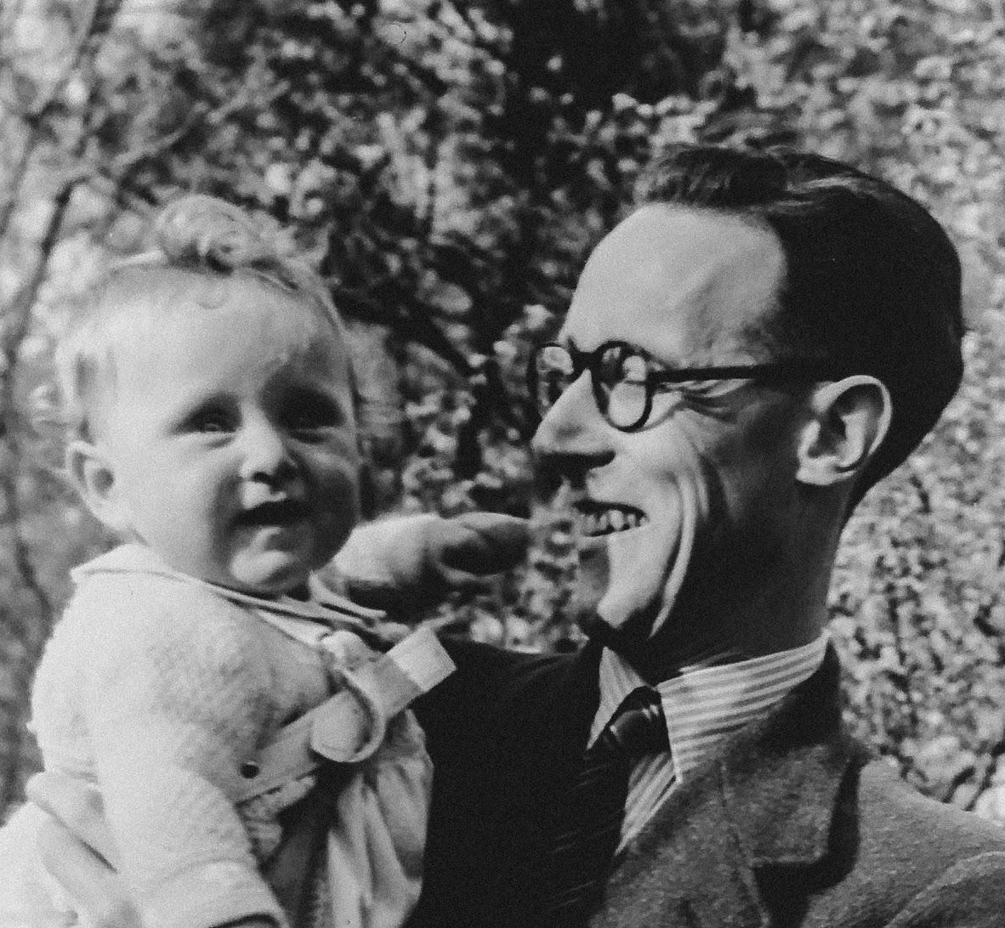
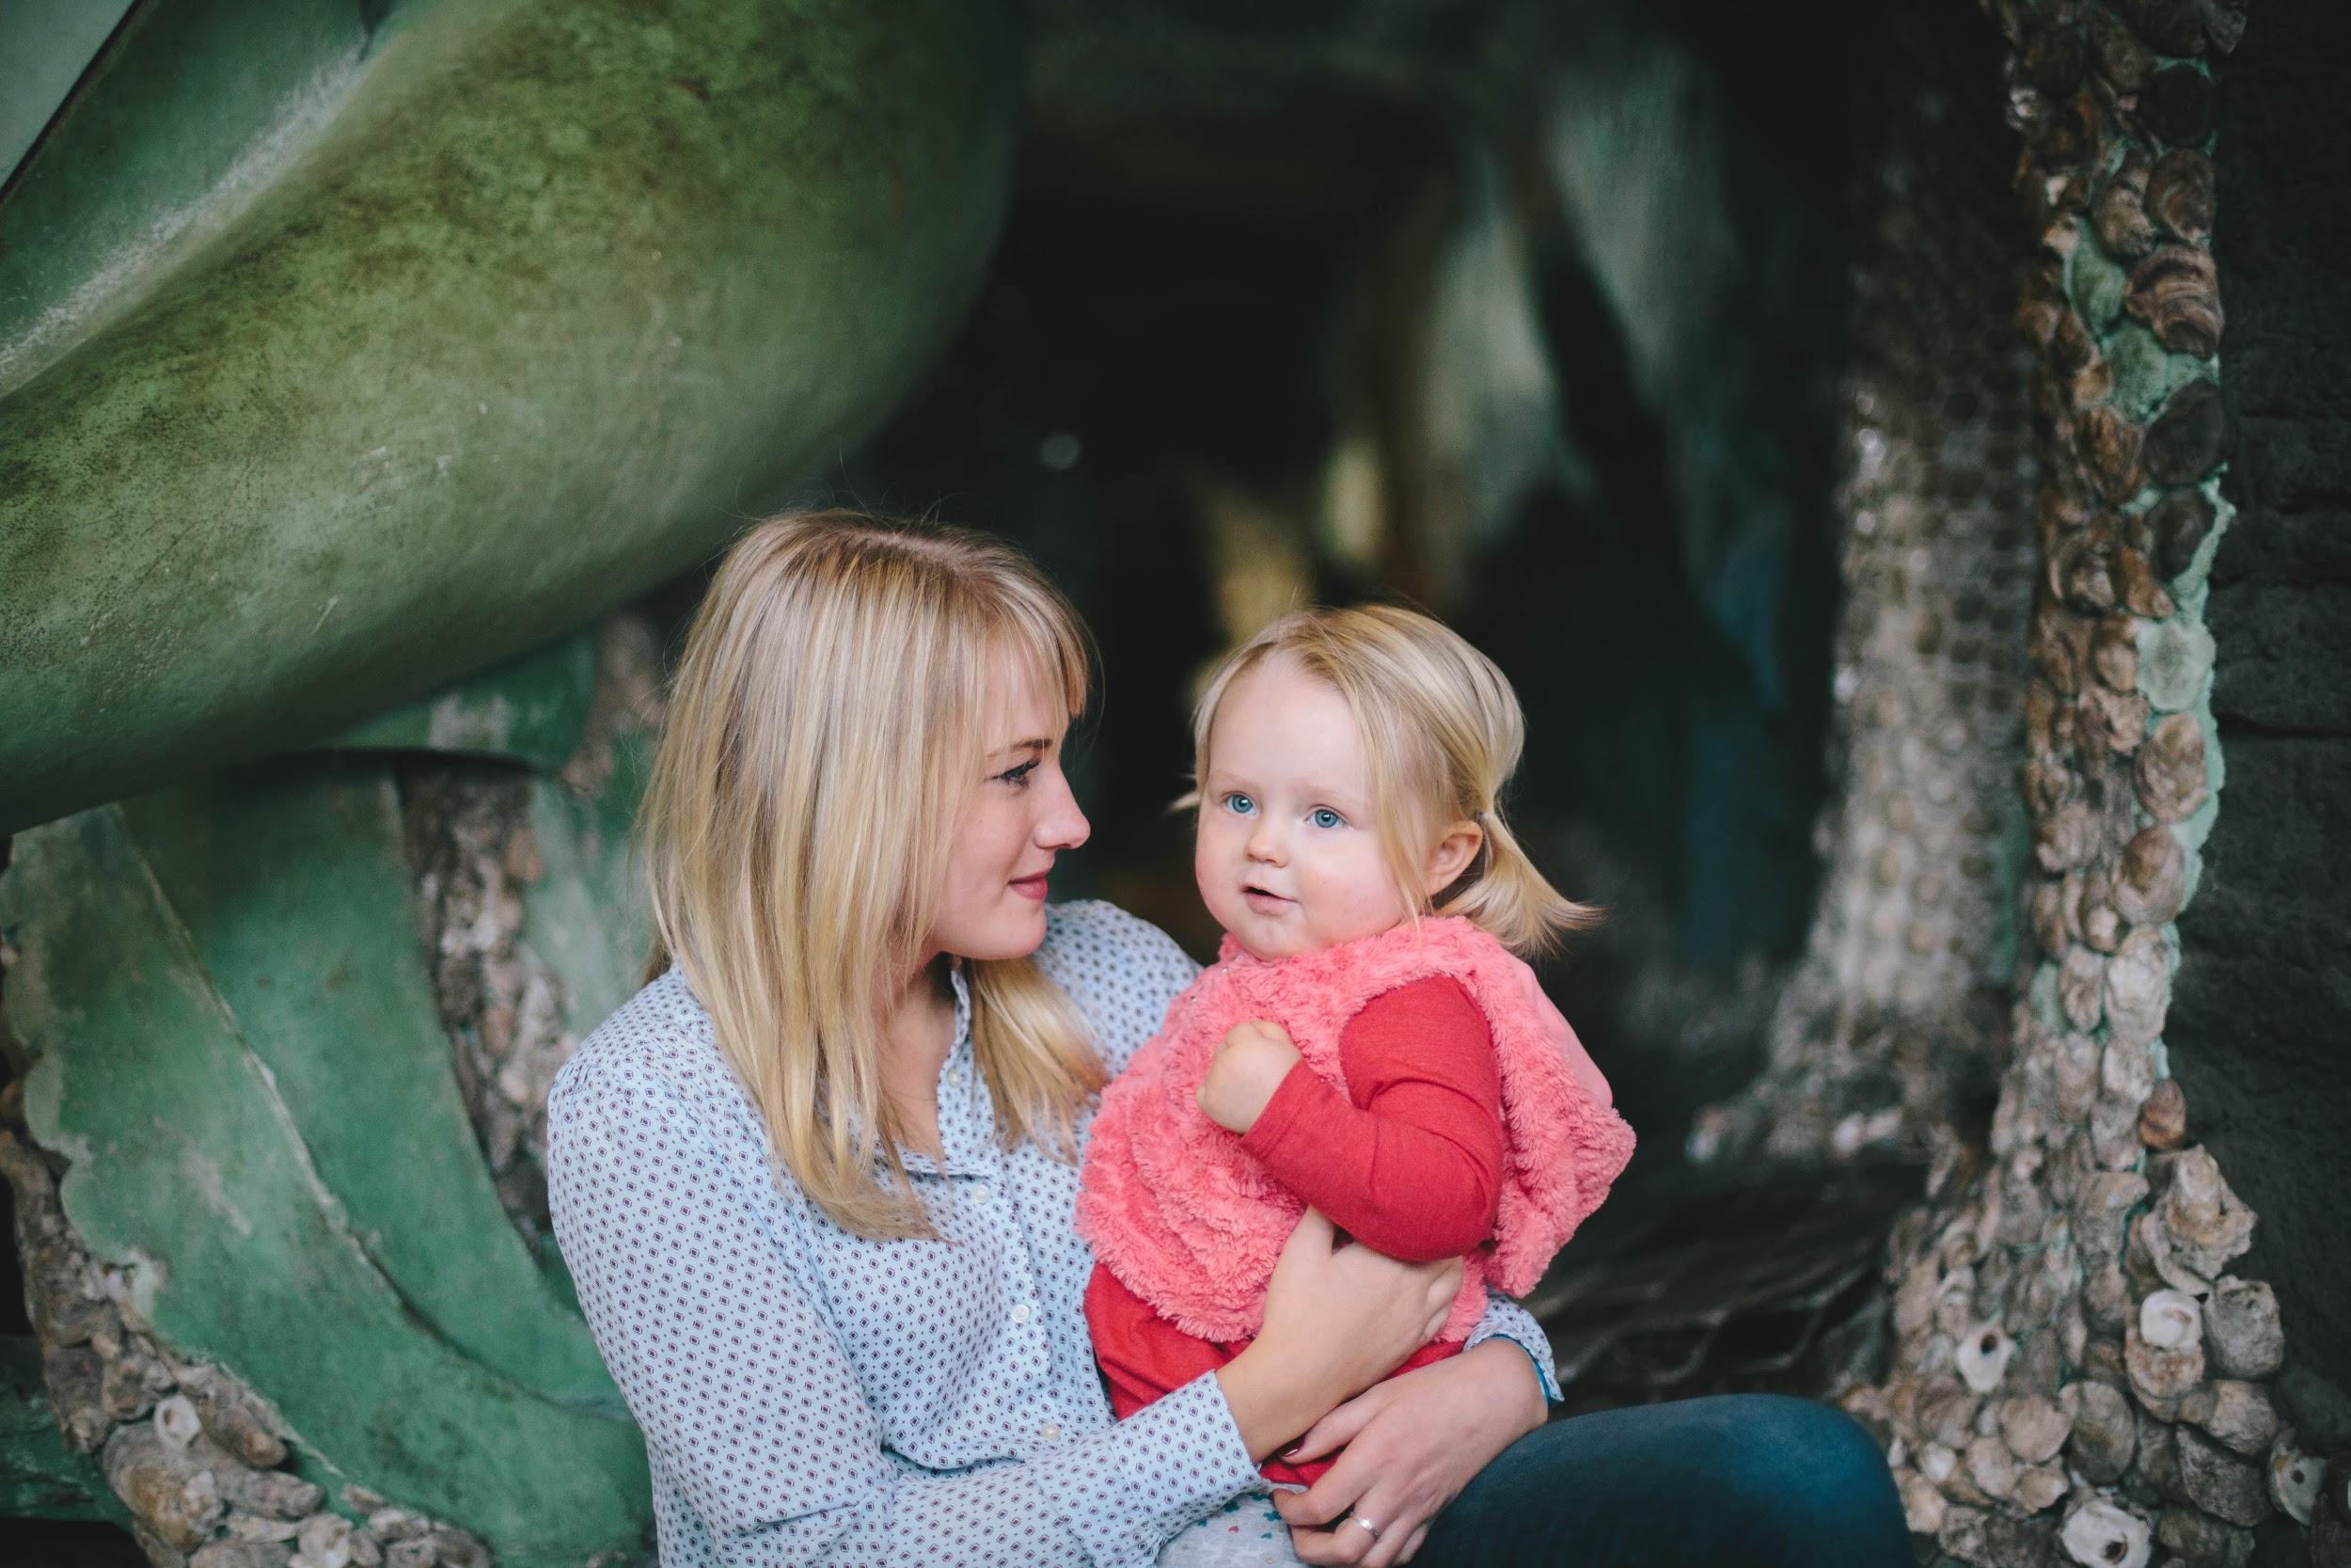
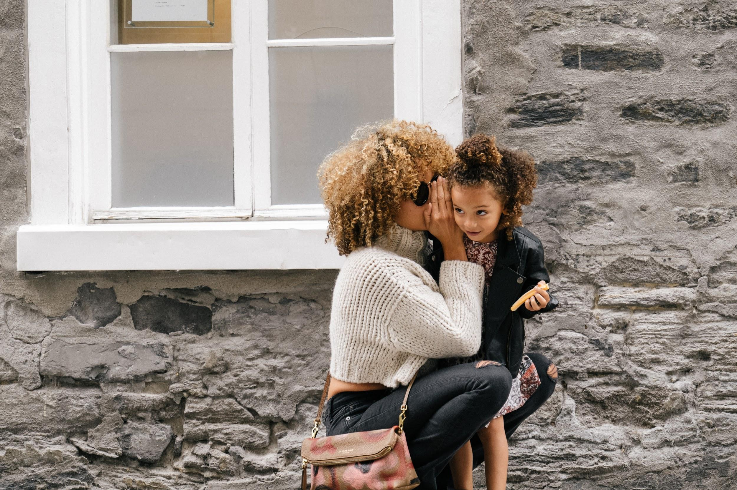
Intro: Speech Corpora
Speech
Speech
Speech

Slide 6
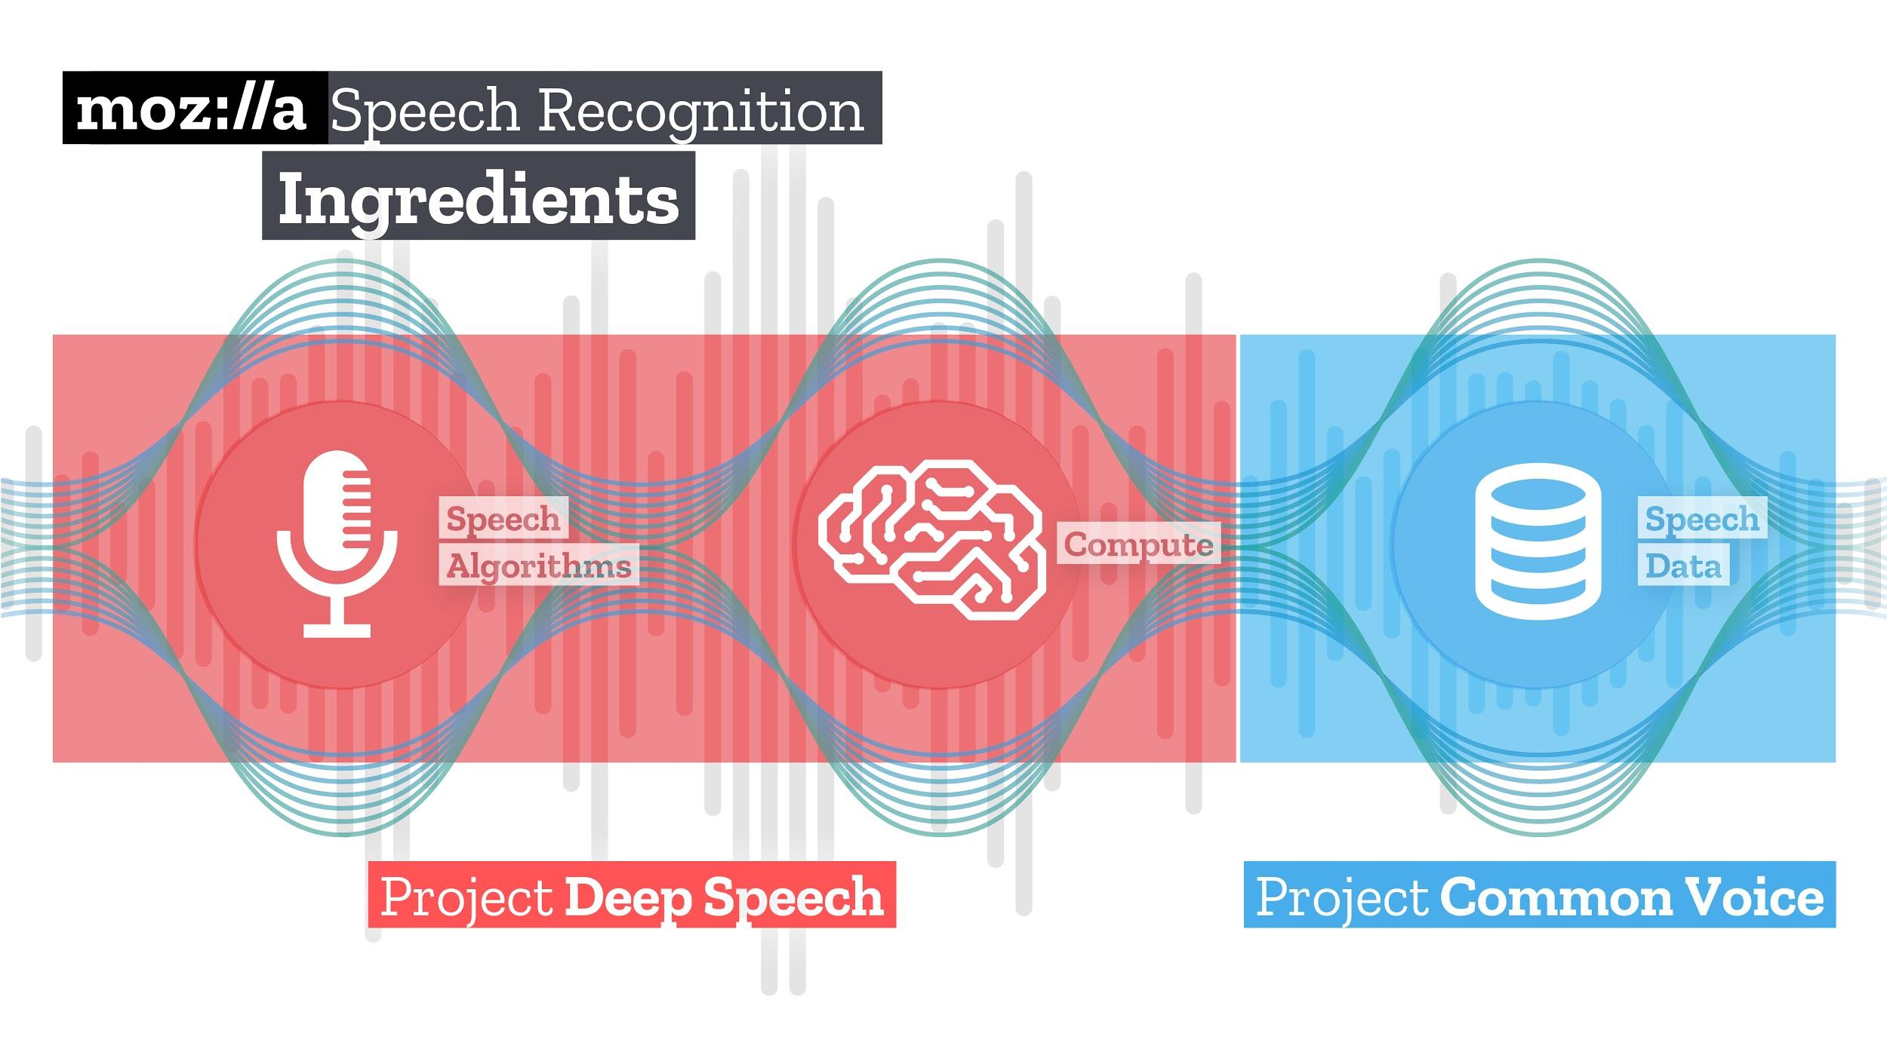
Intro: Common Voice

Slide 7
2 Speech Corpora

Slide 8


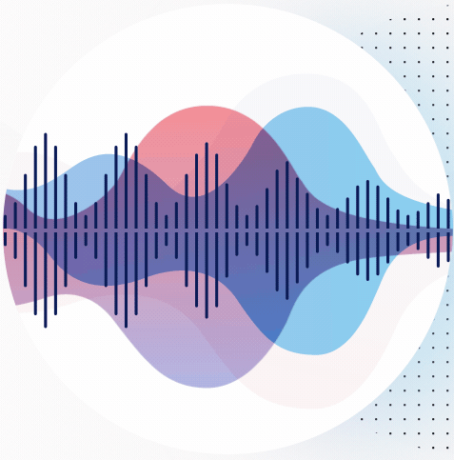

Speech Corpora: Open English Data
"gentle" container
LibriSpeech
Common Voice

Slide 9

Speech Corpora: Closed English Data
Fisher Corpus
Switchboard Corpus

Slide 10
Speech Corpora: English Data
LibriSpeech
Common Voice
Fisher Corpus
Switchboard Corpus

Slide 11
Speech Corpora: Open Non-English Data

Slide 12
Speech Corpora: Open Non-English Data
Common Voice

Slide 13
Speech Corpora: Closed Non-English Data

Slide 14
Speech Corpora: Non-English Data
Common Voice

Slide 15
3 Common Voice

Slide 16
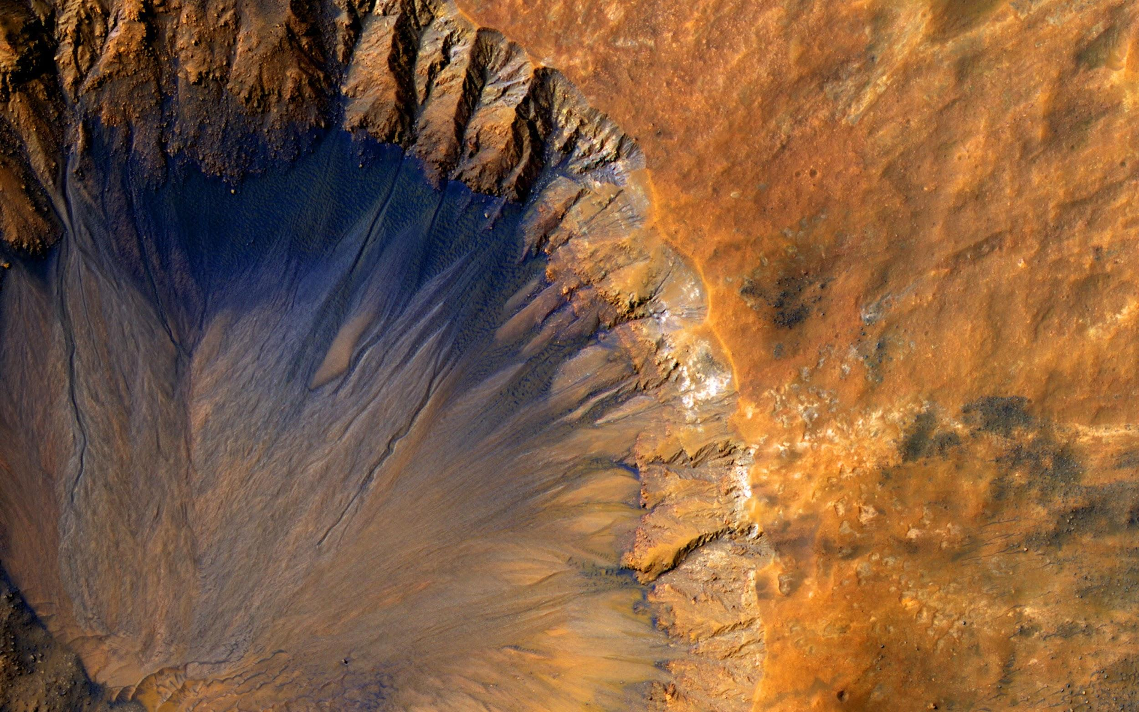
3.1 Frontend

Slide 17

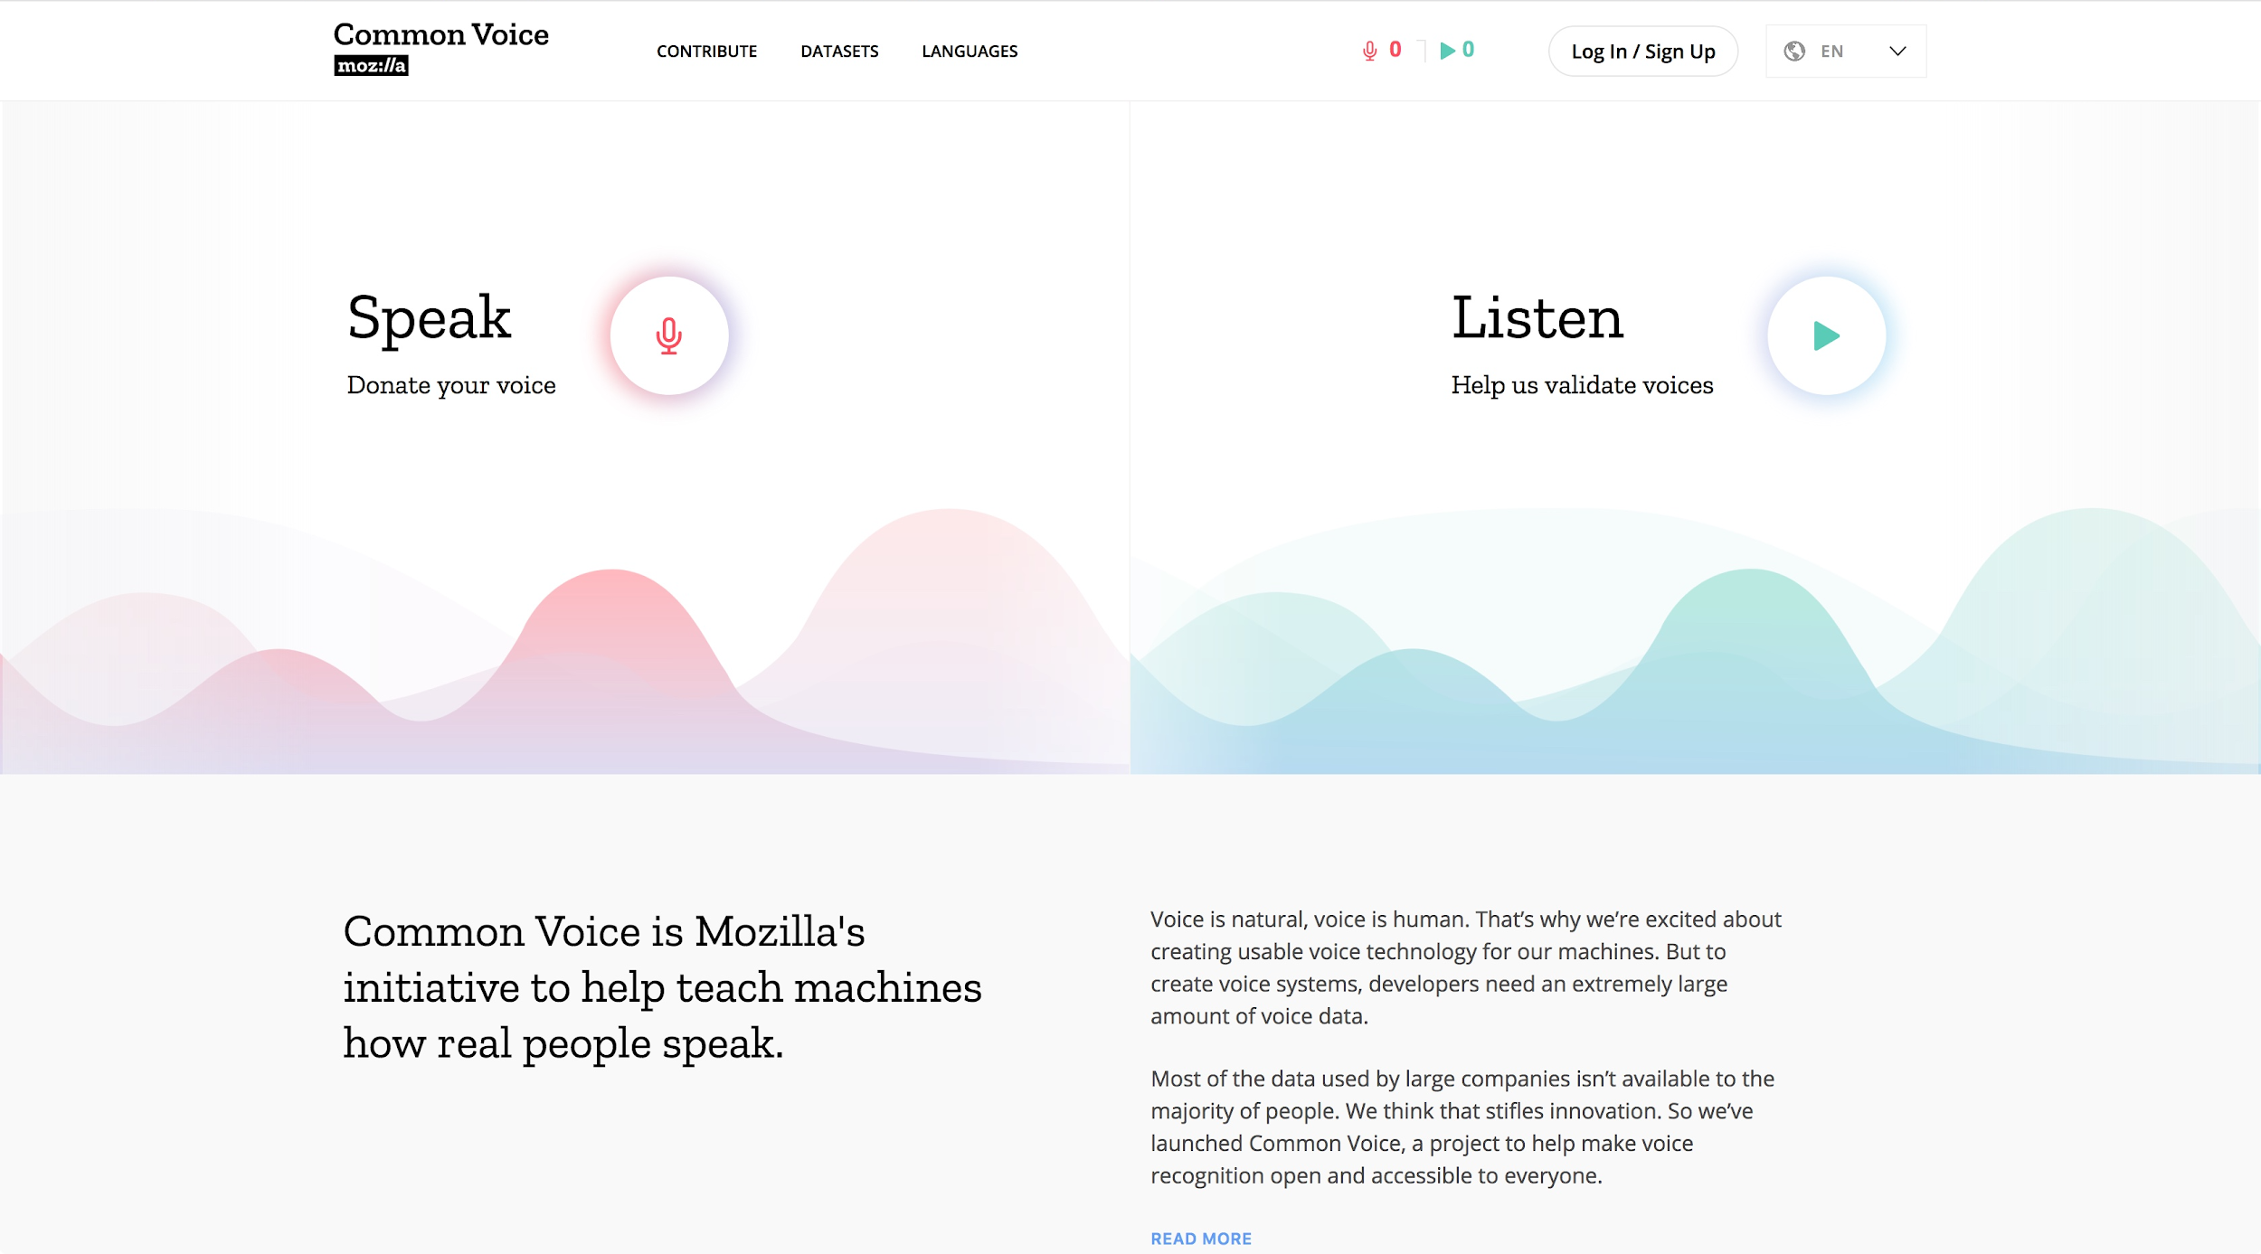
Frontend: Homepage

Slide 18
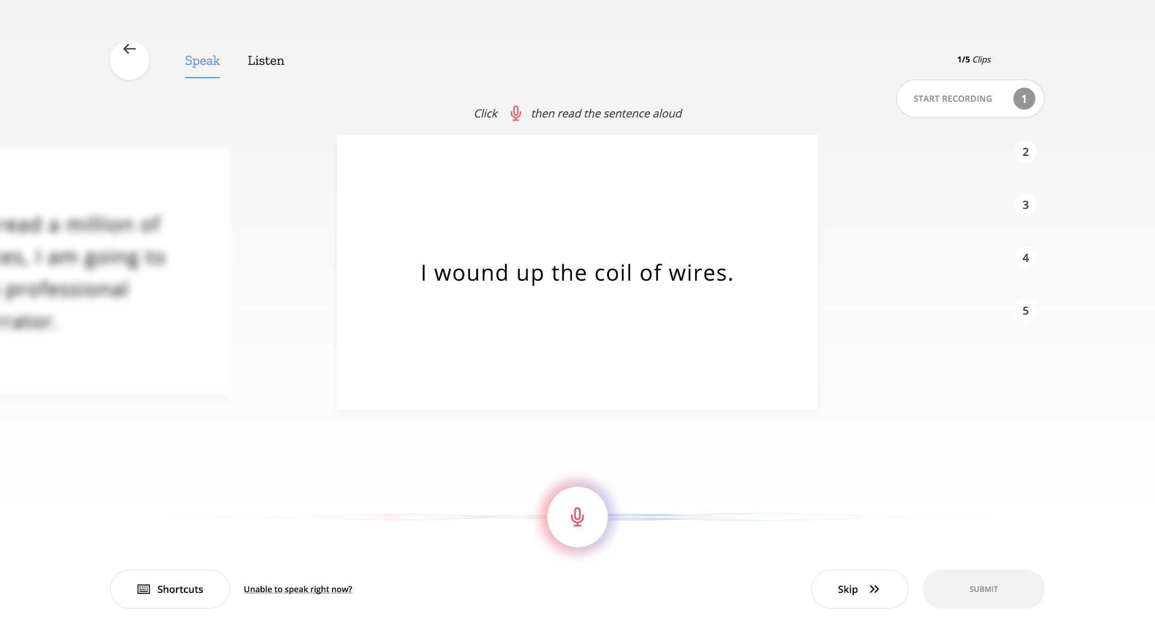
Frontend: Speak

Slide 19
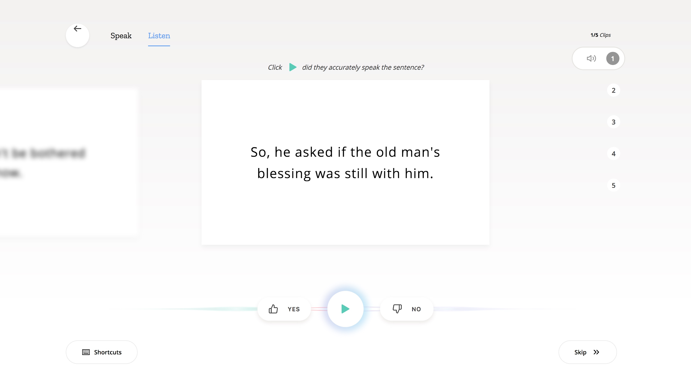
Frontend: Listen

Slide 20
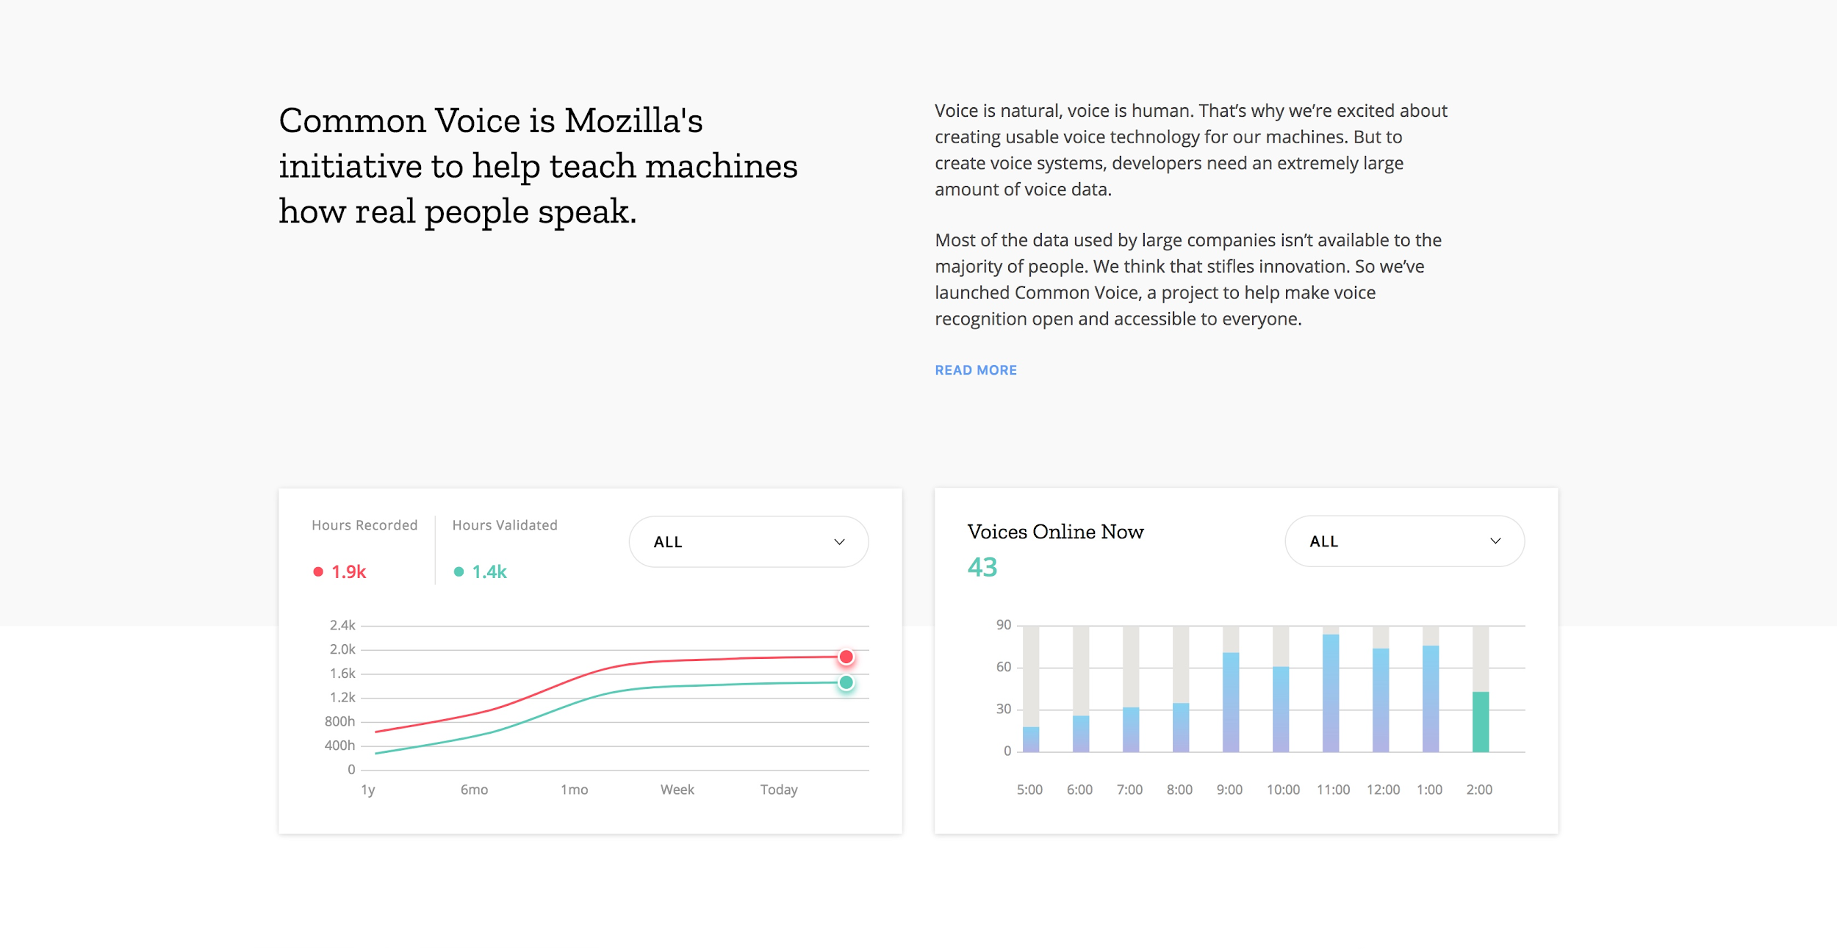
Frontend: General Statistics

Slide 21
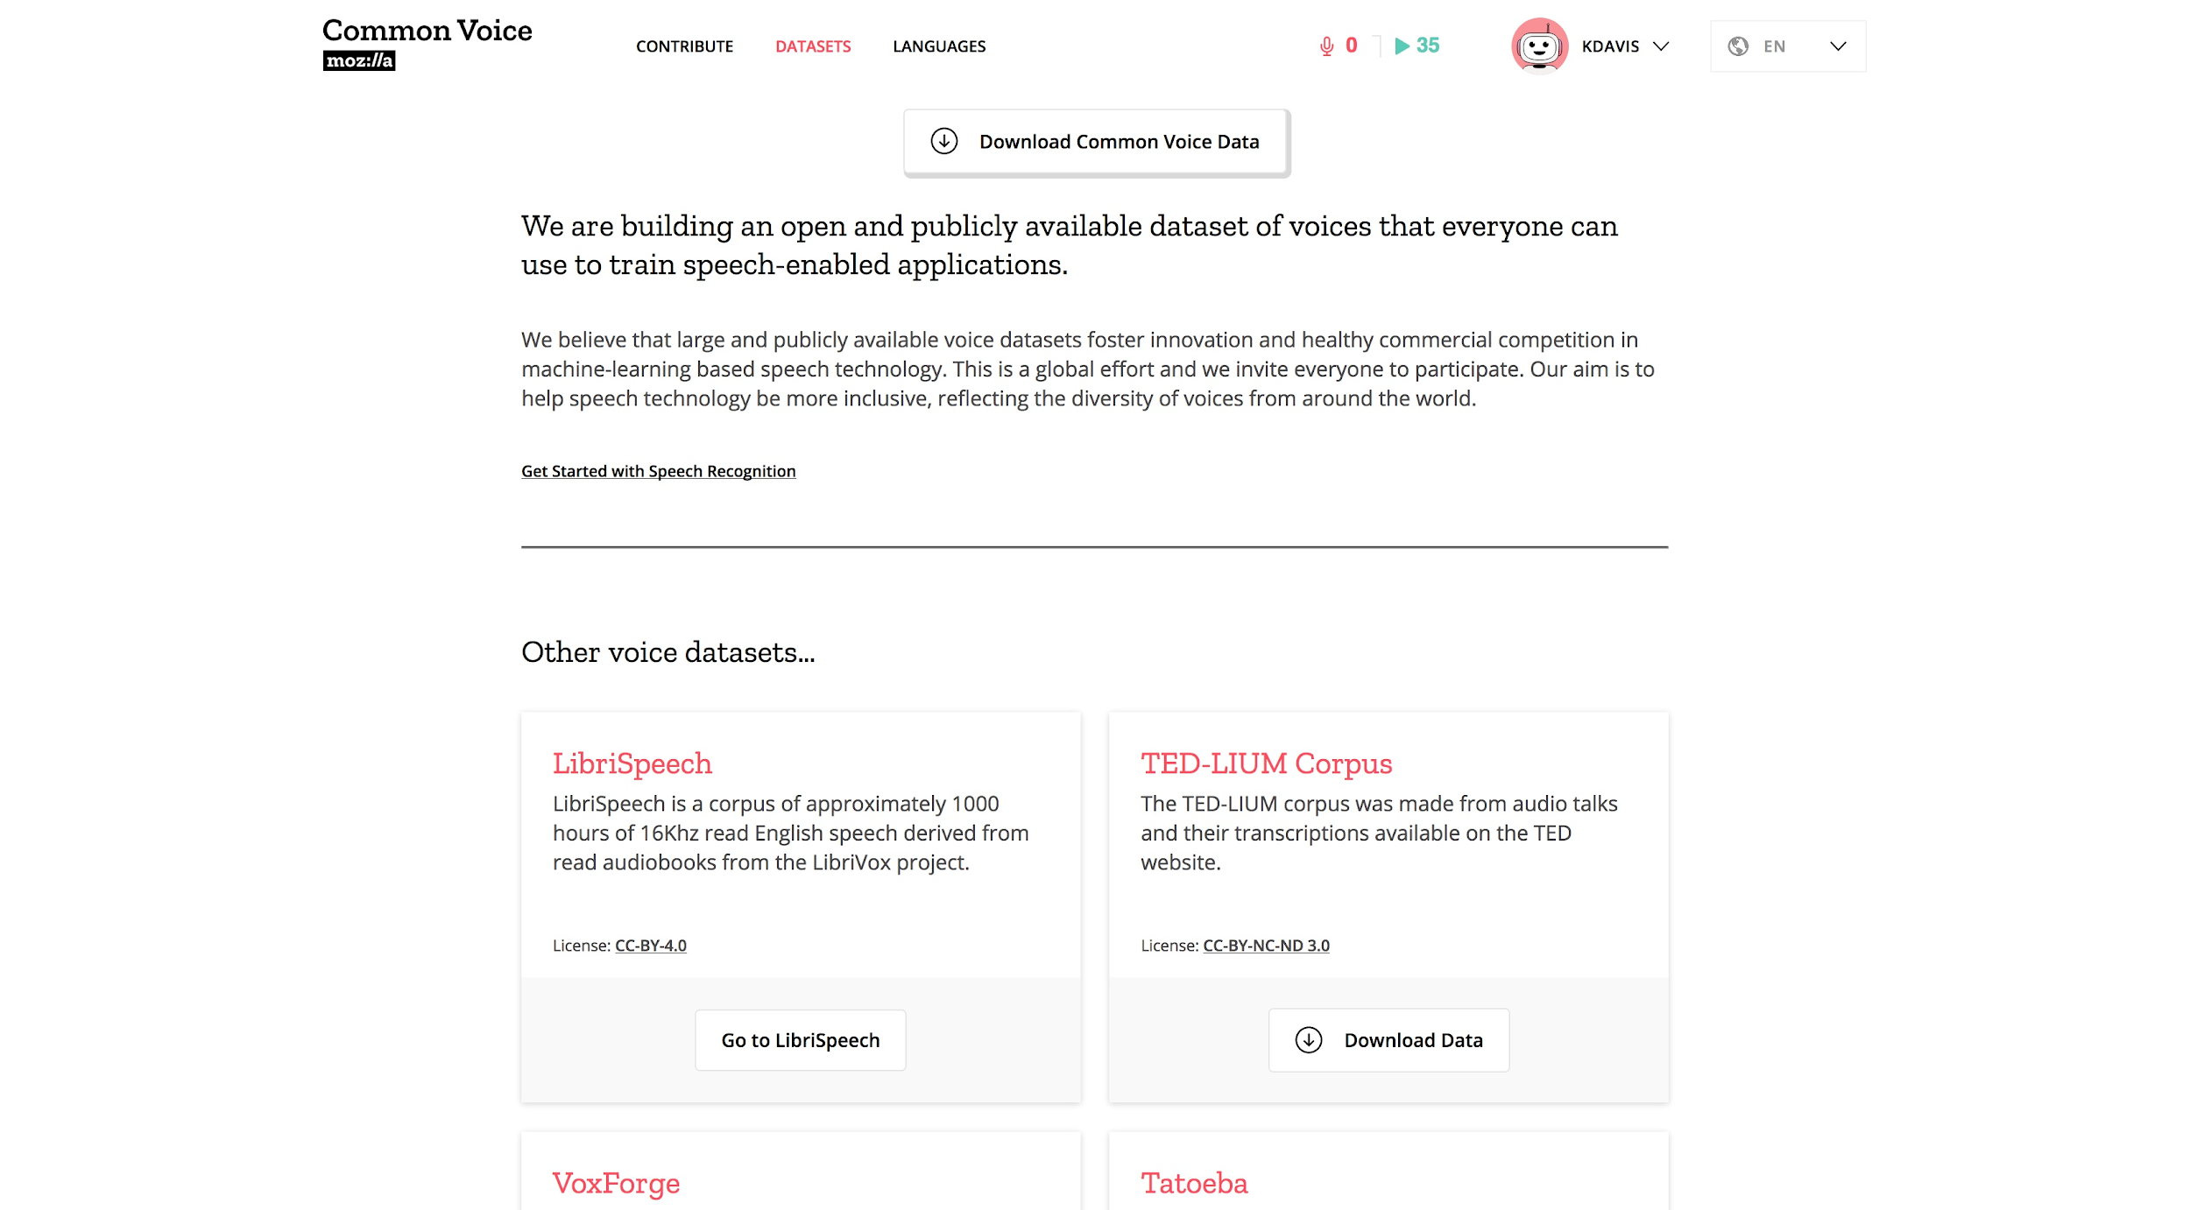
Frontend: Datasets

Slide 22
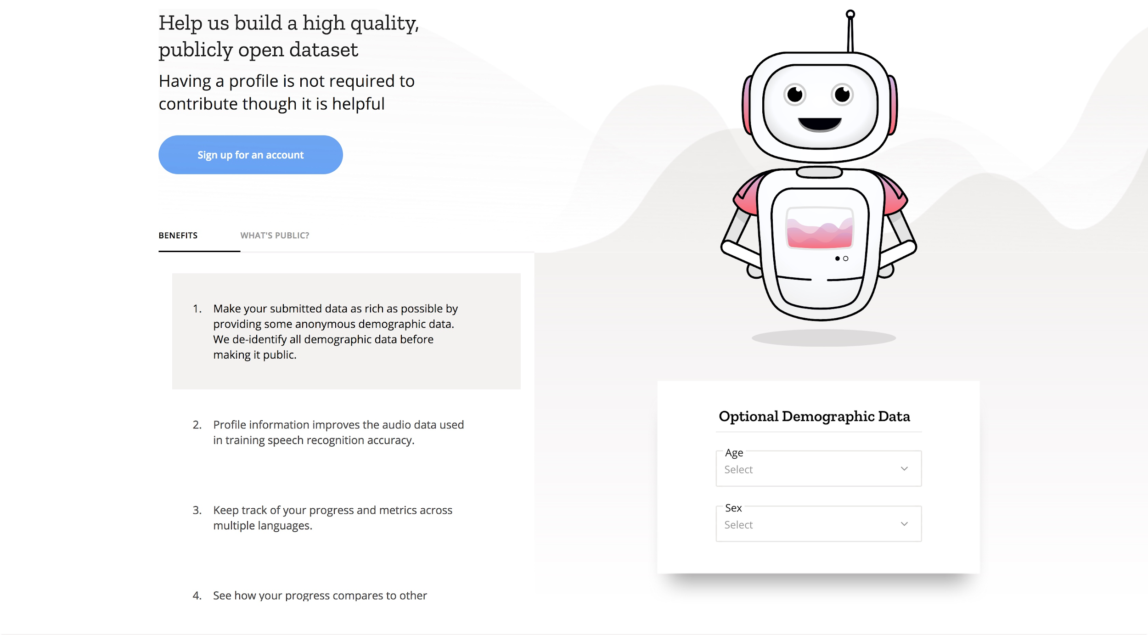
Frontend: Profile Sign-Up

Slide 23
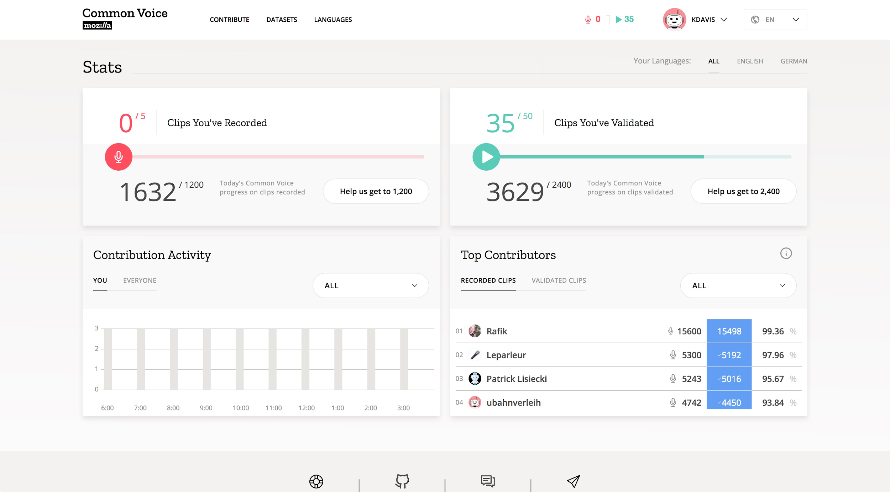
Frontend: Dashboard

Slide 24
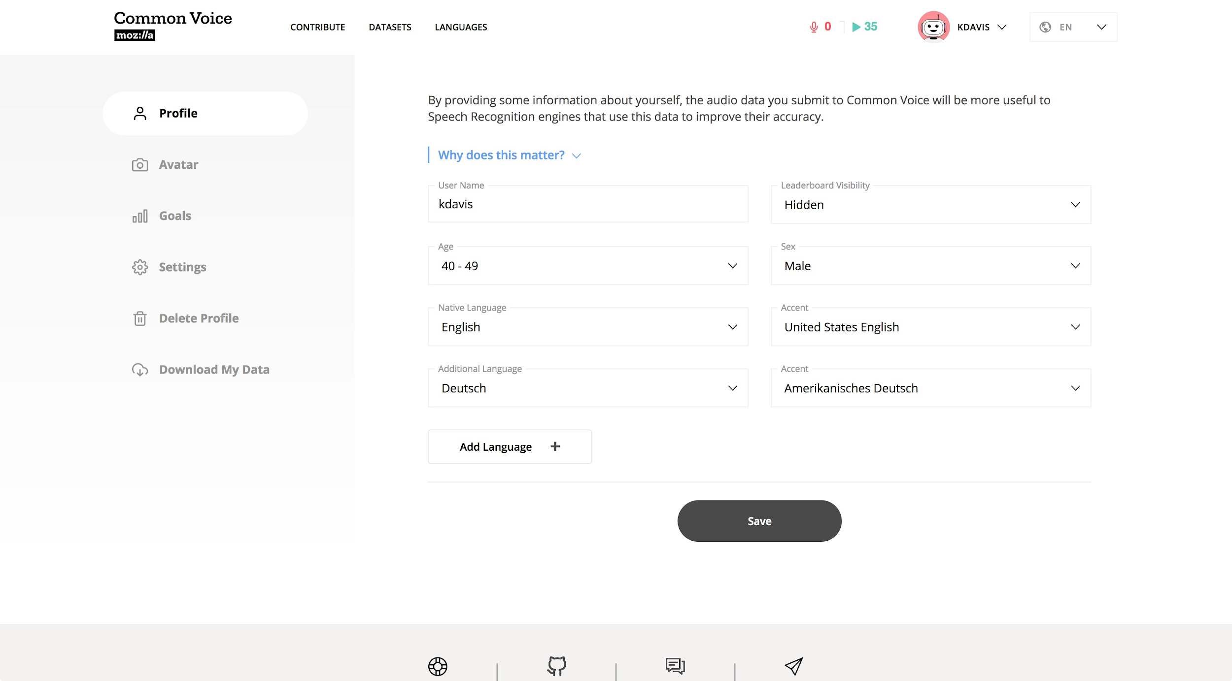
Frontend: Profile: Demographics

Slide 25
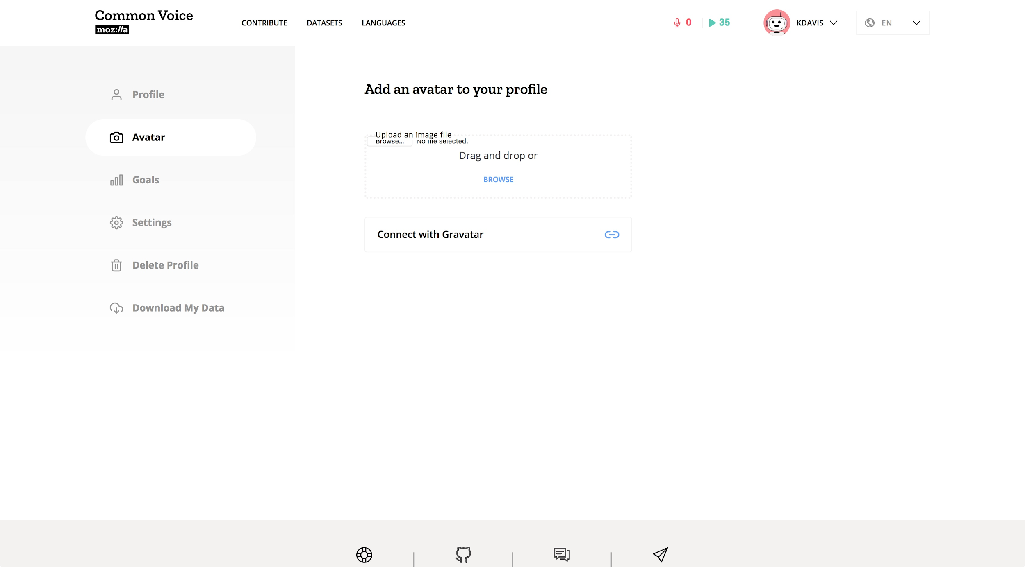
Frontend: Profile: Avitar

Slide 26
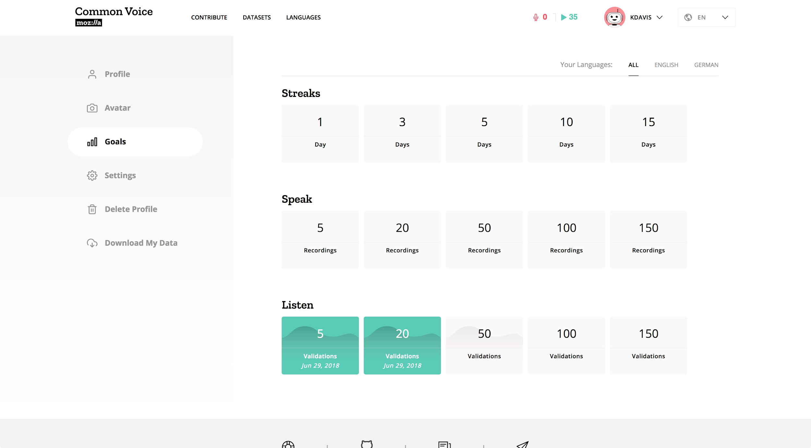
Frontend: Profile: Goals

Slide 27
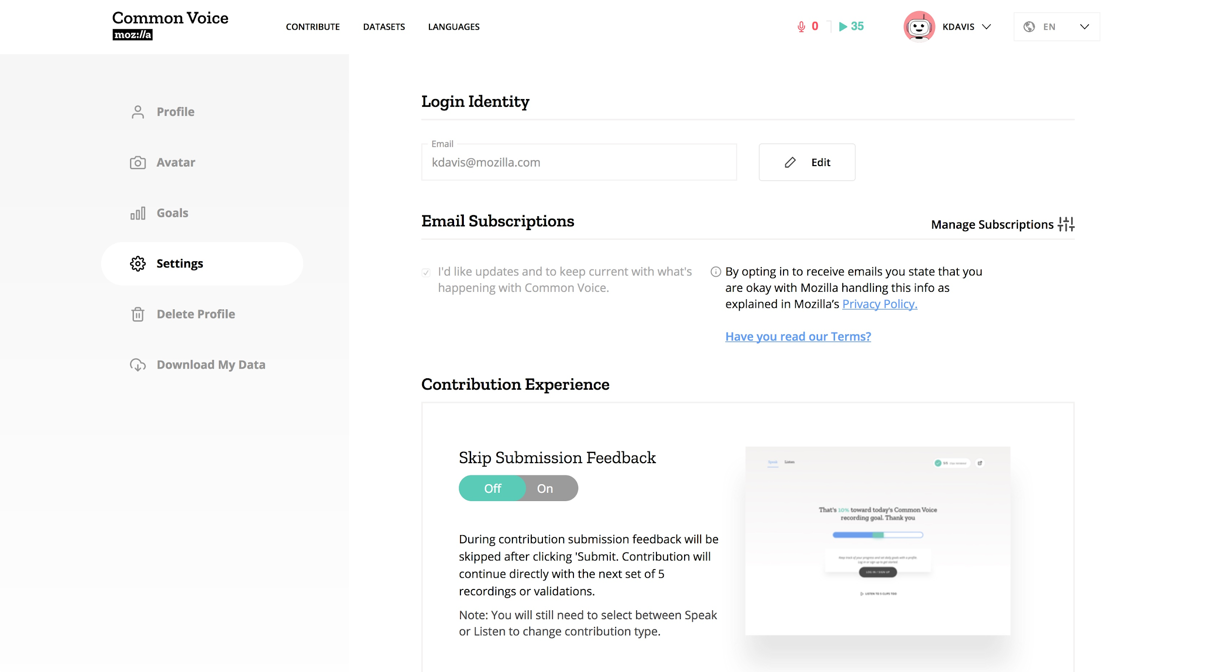
Frontend: Profile: Settings

Slide 28
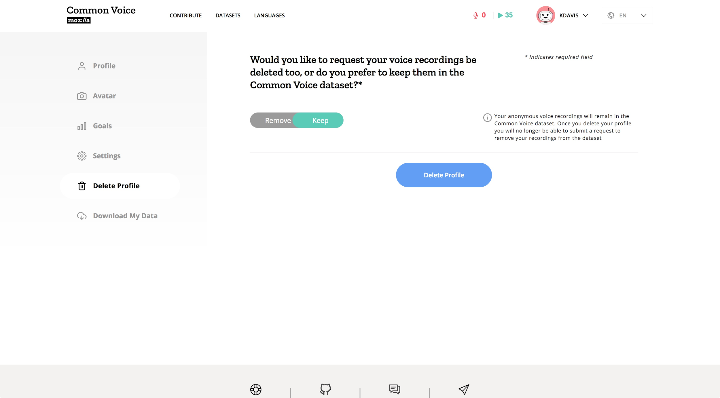
Frontend: Profile: Delete Profile

Slide 29
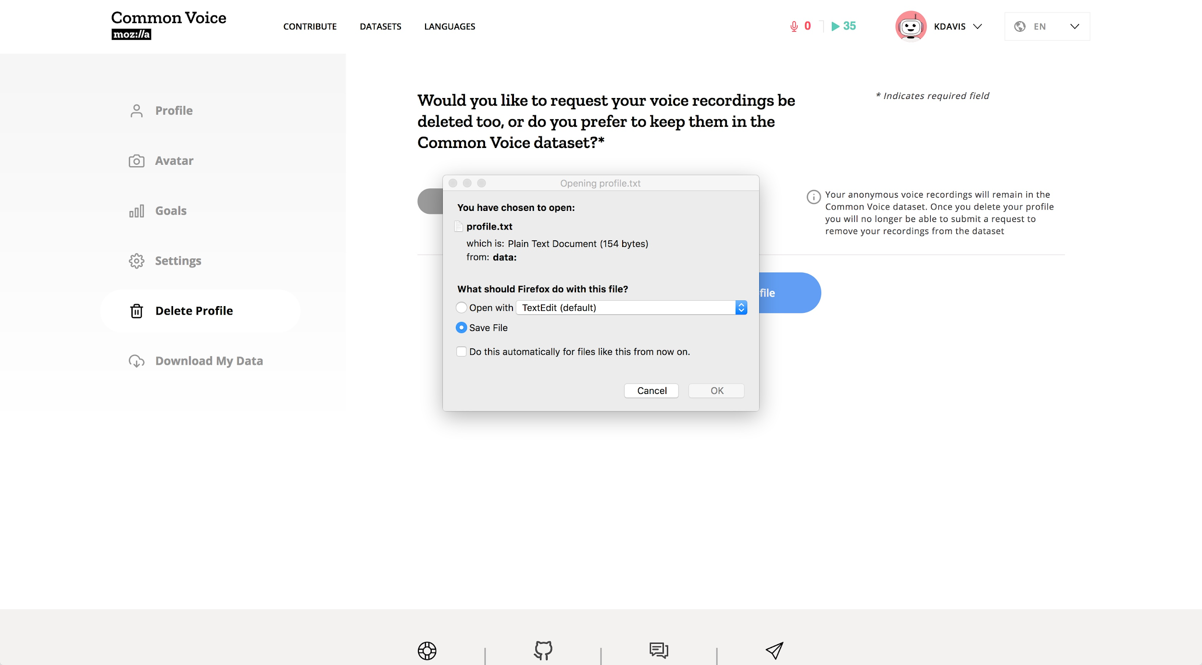
Frontend: Profile: Download My Data

Slide 30
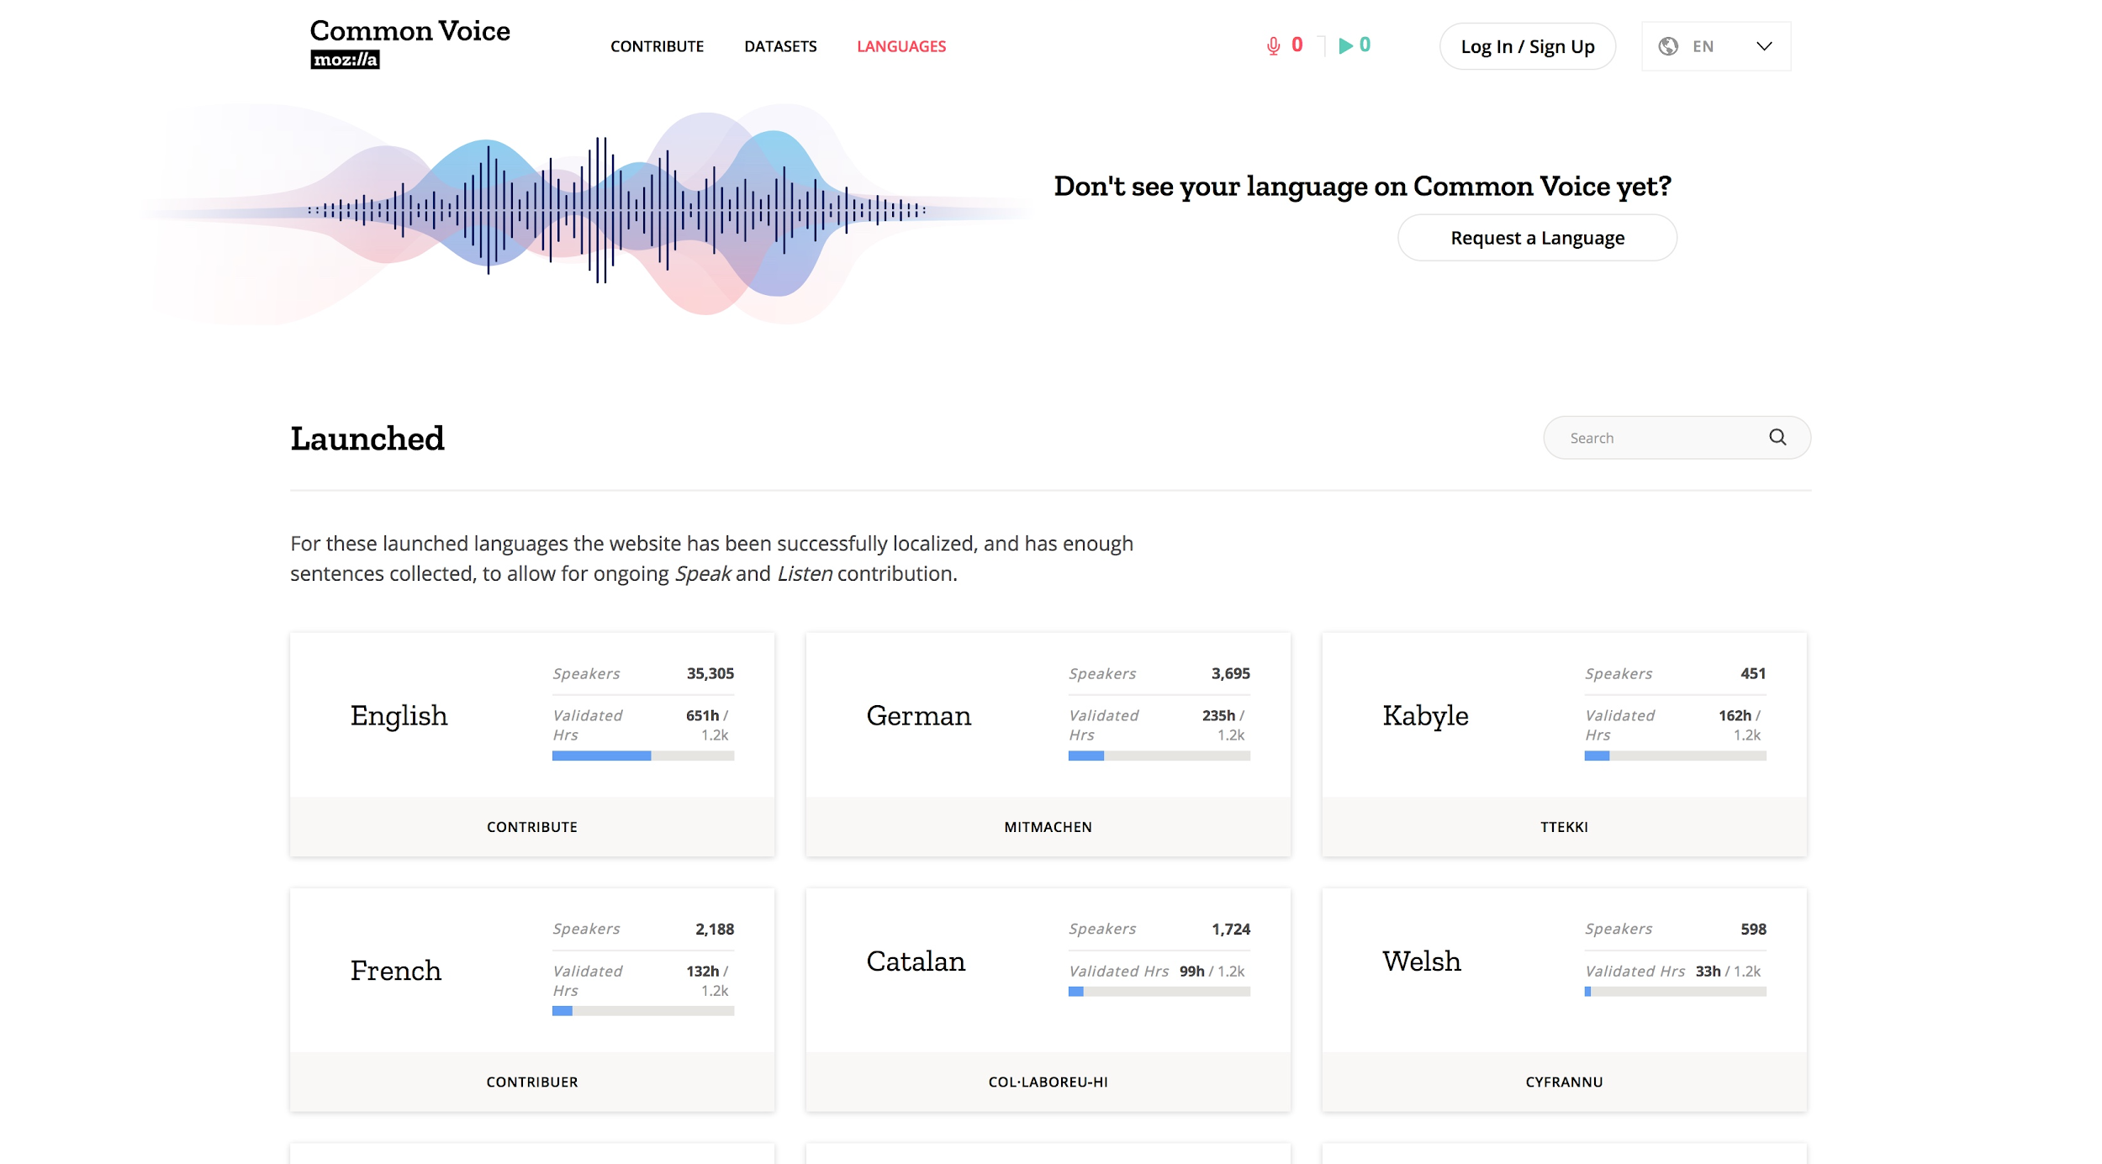
Frontend: Languages...

Slide 31
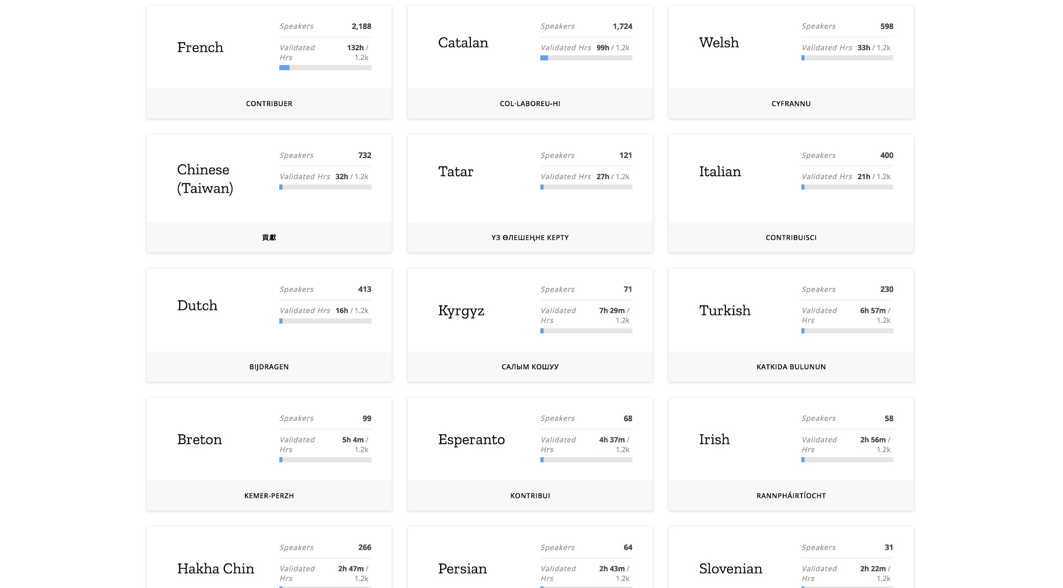
Frontend: Languages...

Slide 32
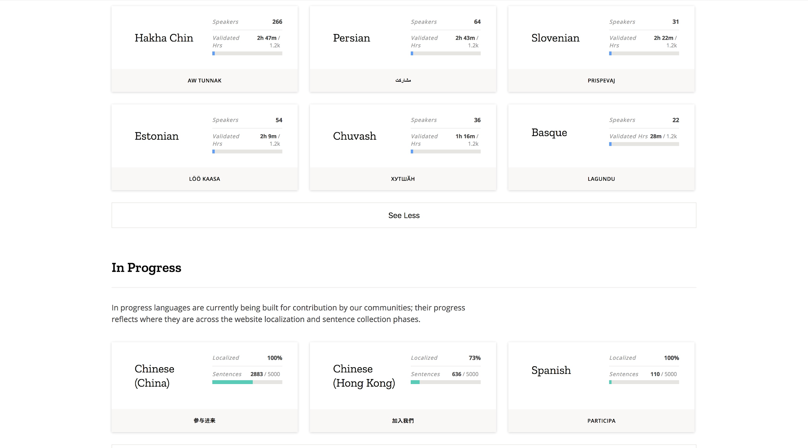
Frontend: Languages...

Slide 33
3.2 Localization

Slide 34
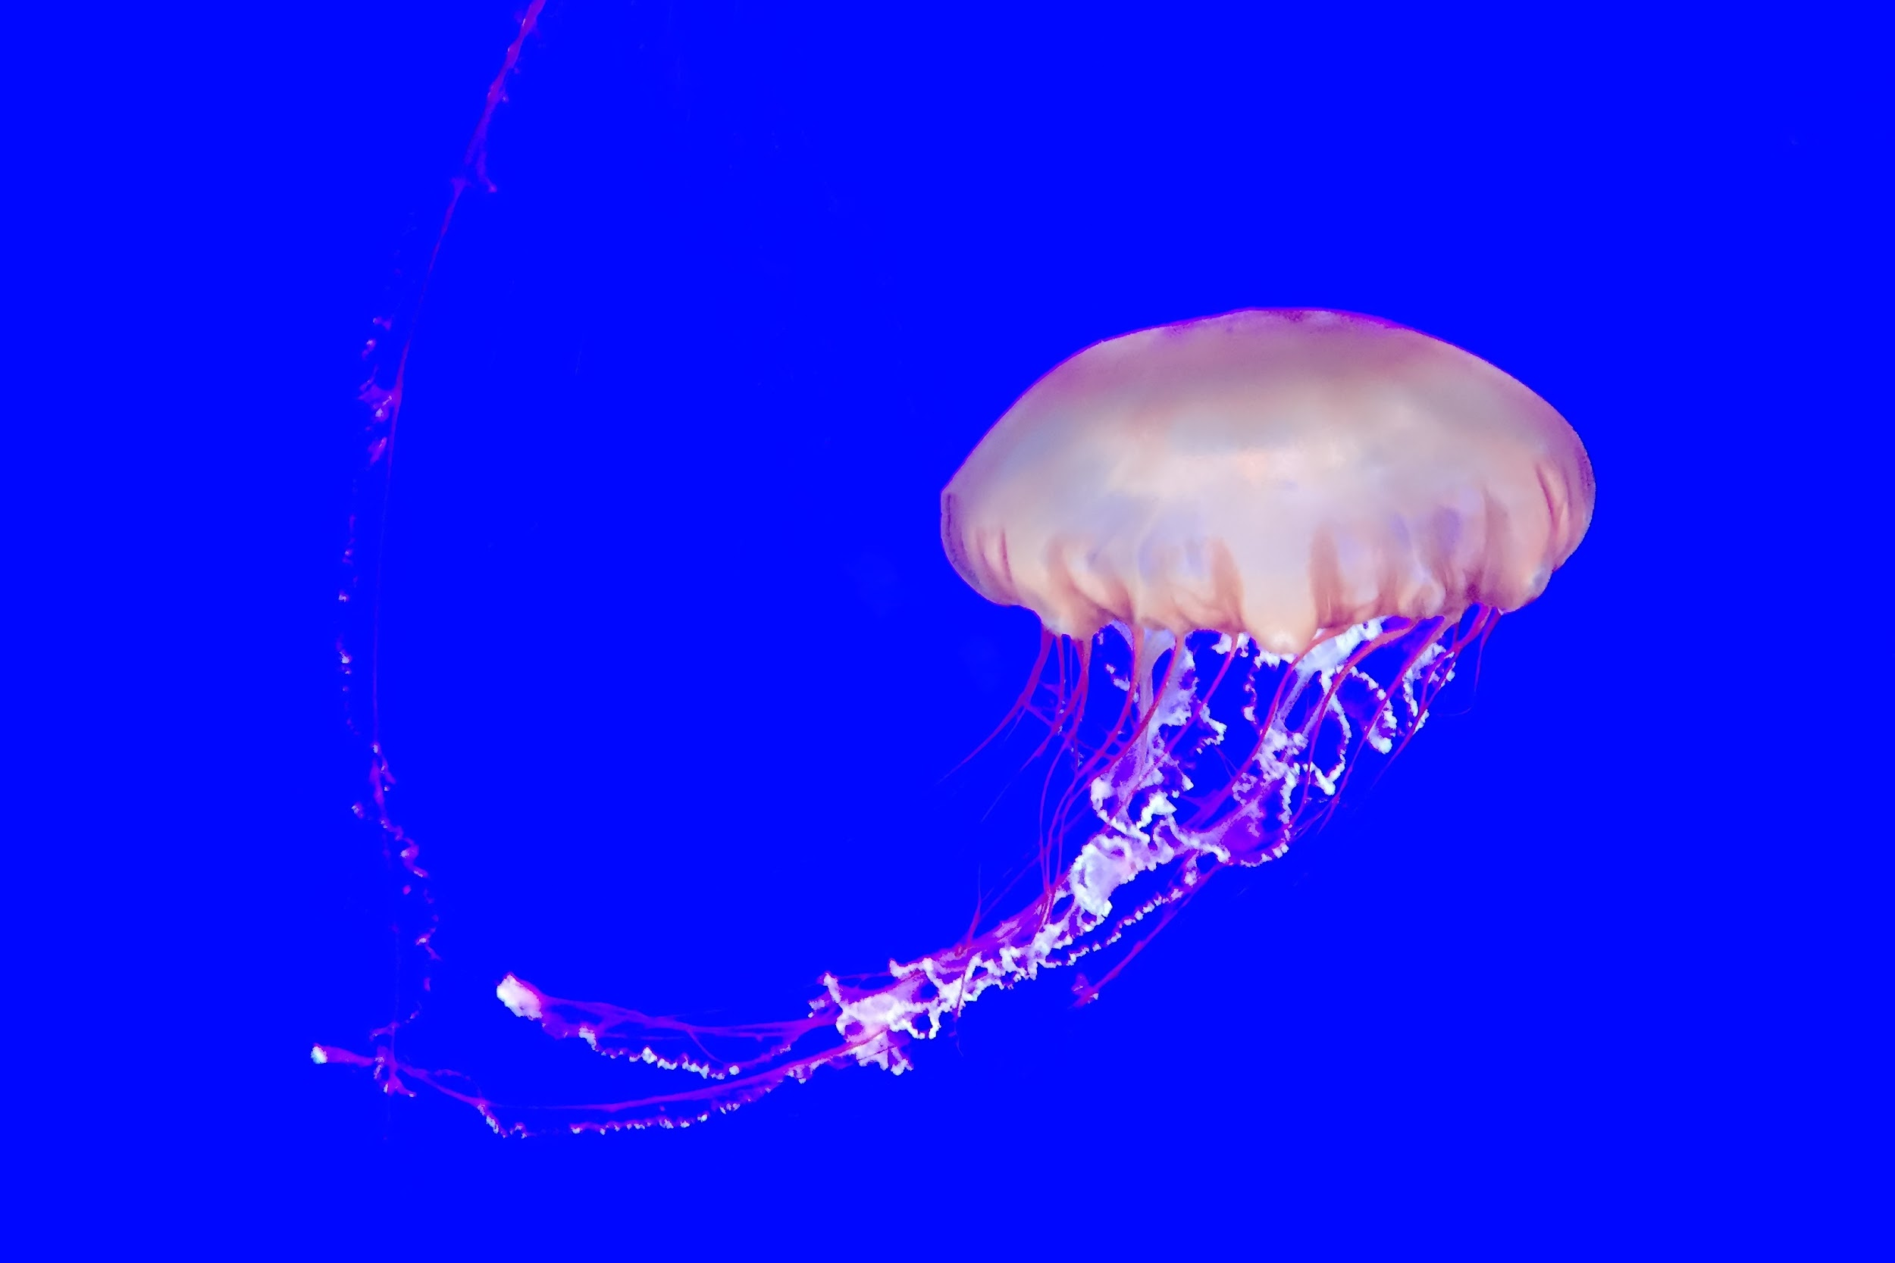
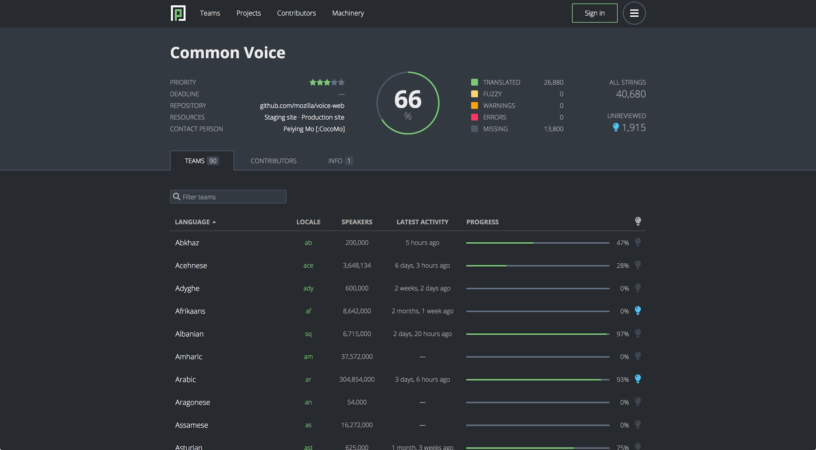
Localization: Pontoon

Slide 35
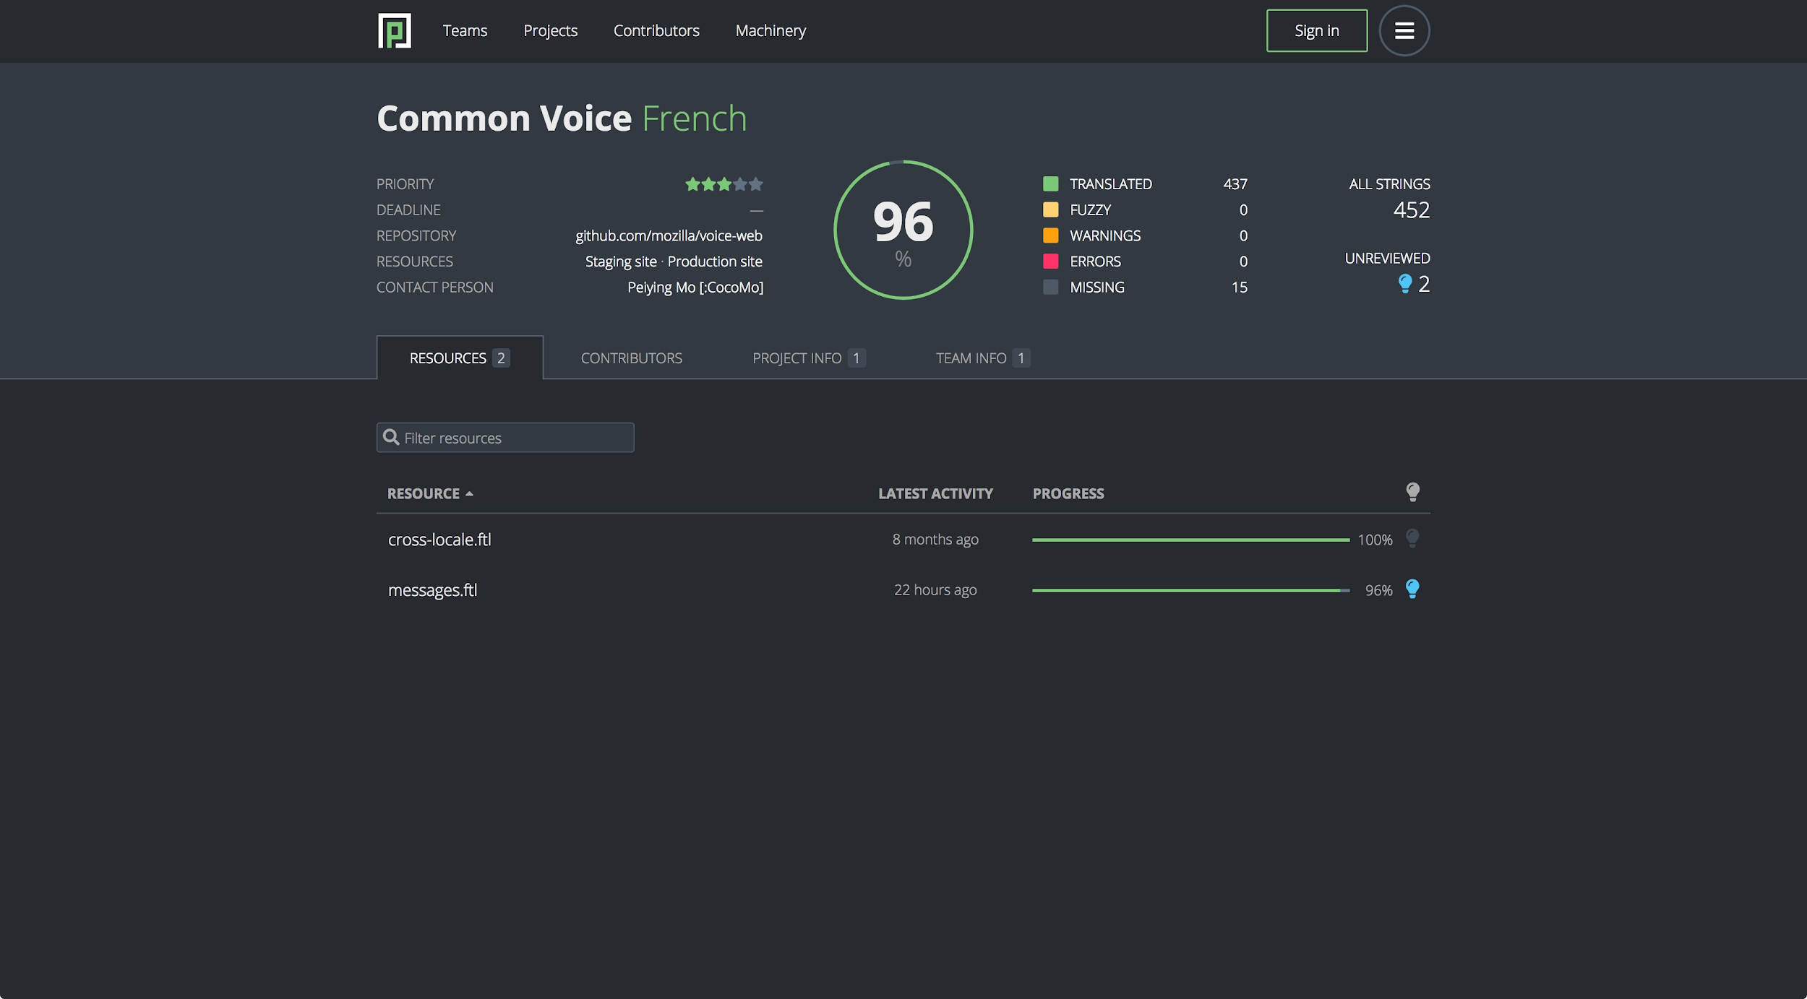
Localization: Pontoon: Resources

Slide 36
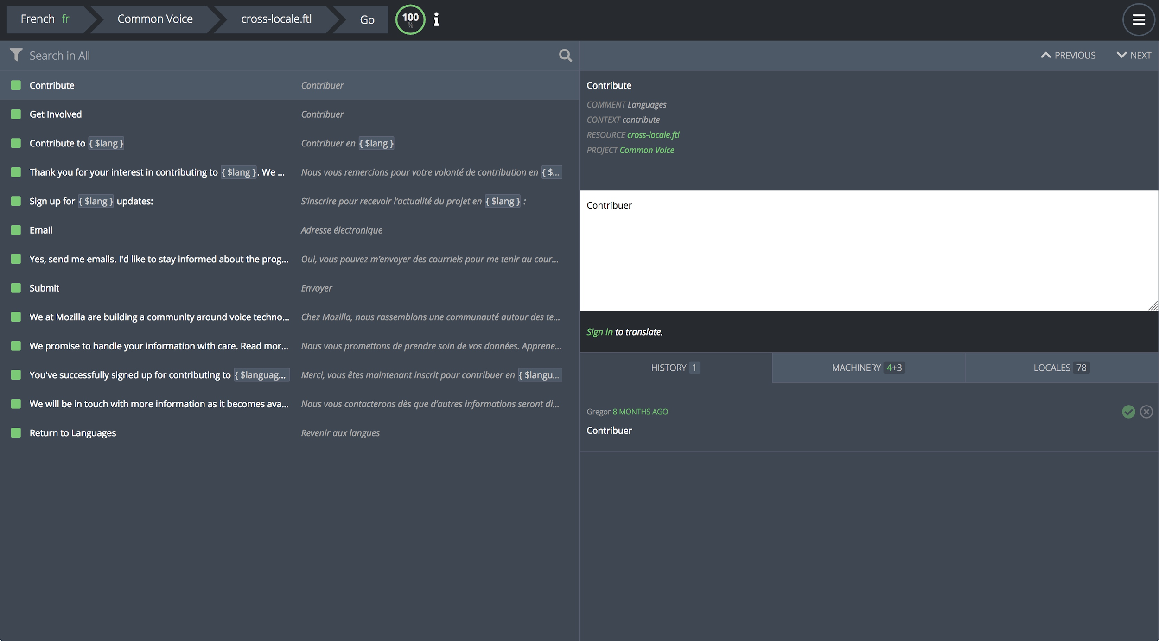
Localization: Pontoon: Resources: cross-locale

Slide 37
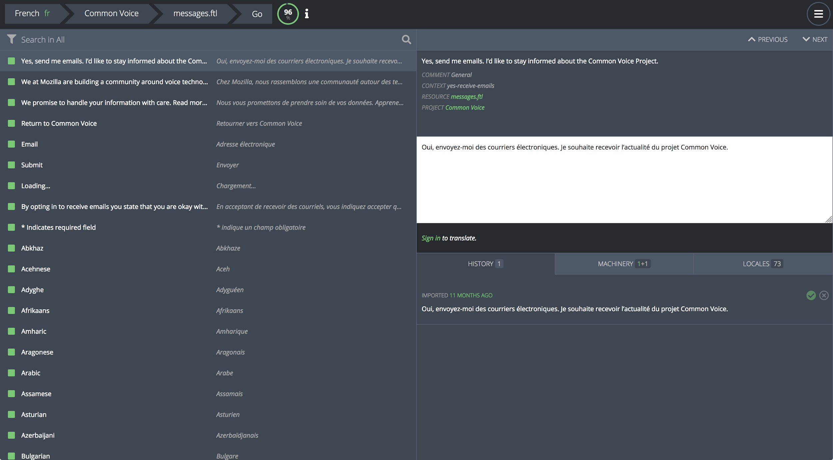
Localization: Pontoon: Resources: messages

Slide 38
3.3 Sentence Collection

Slide 39
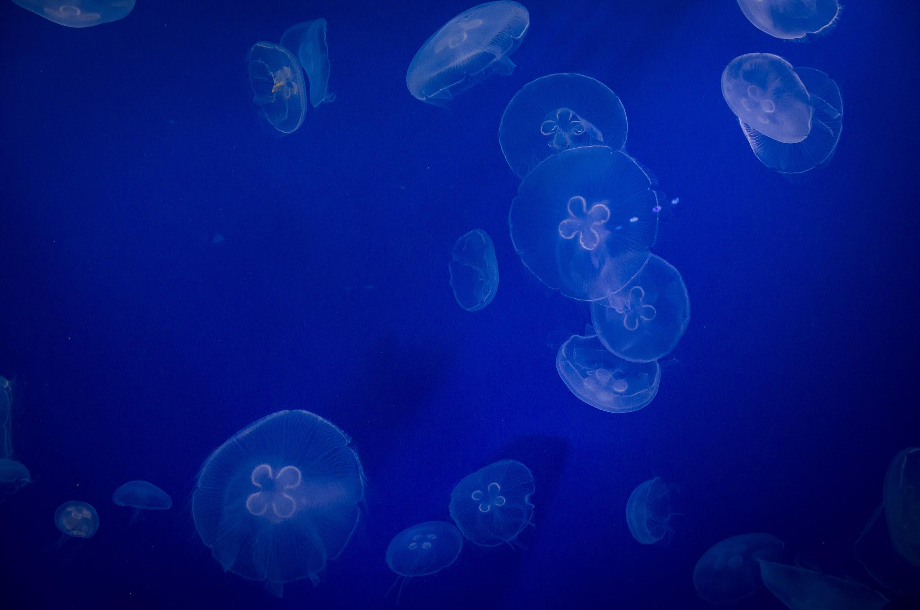
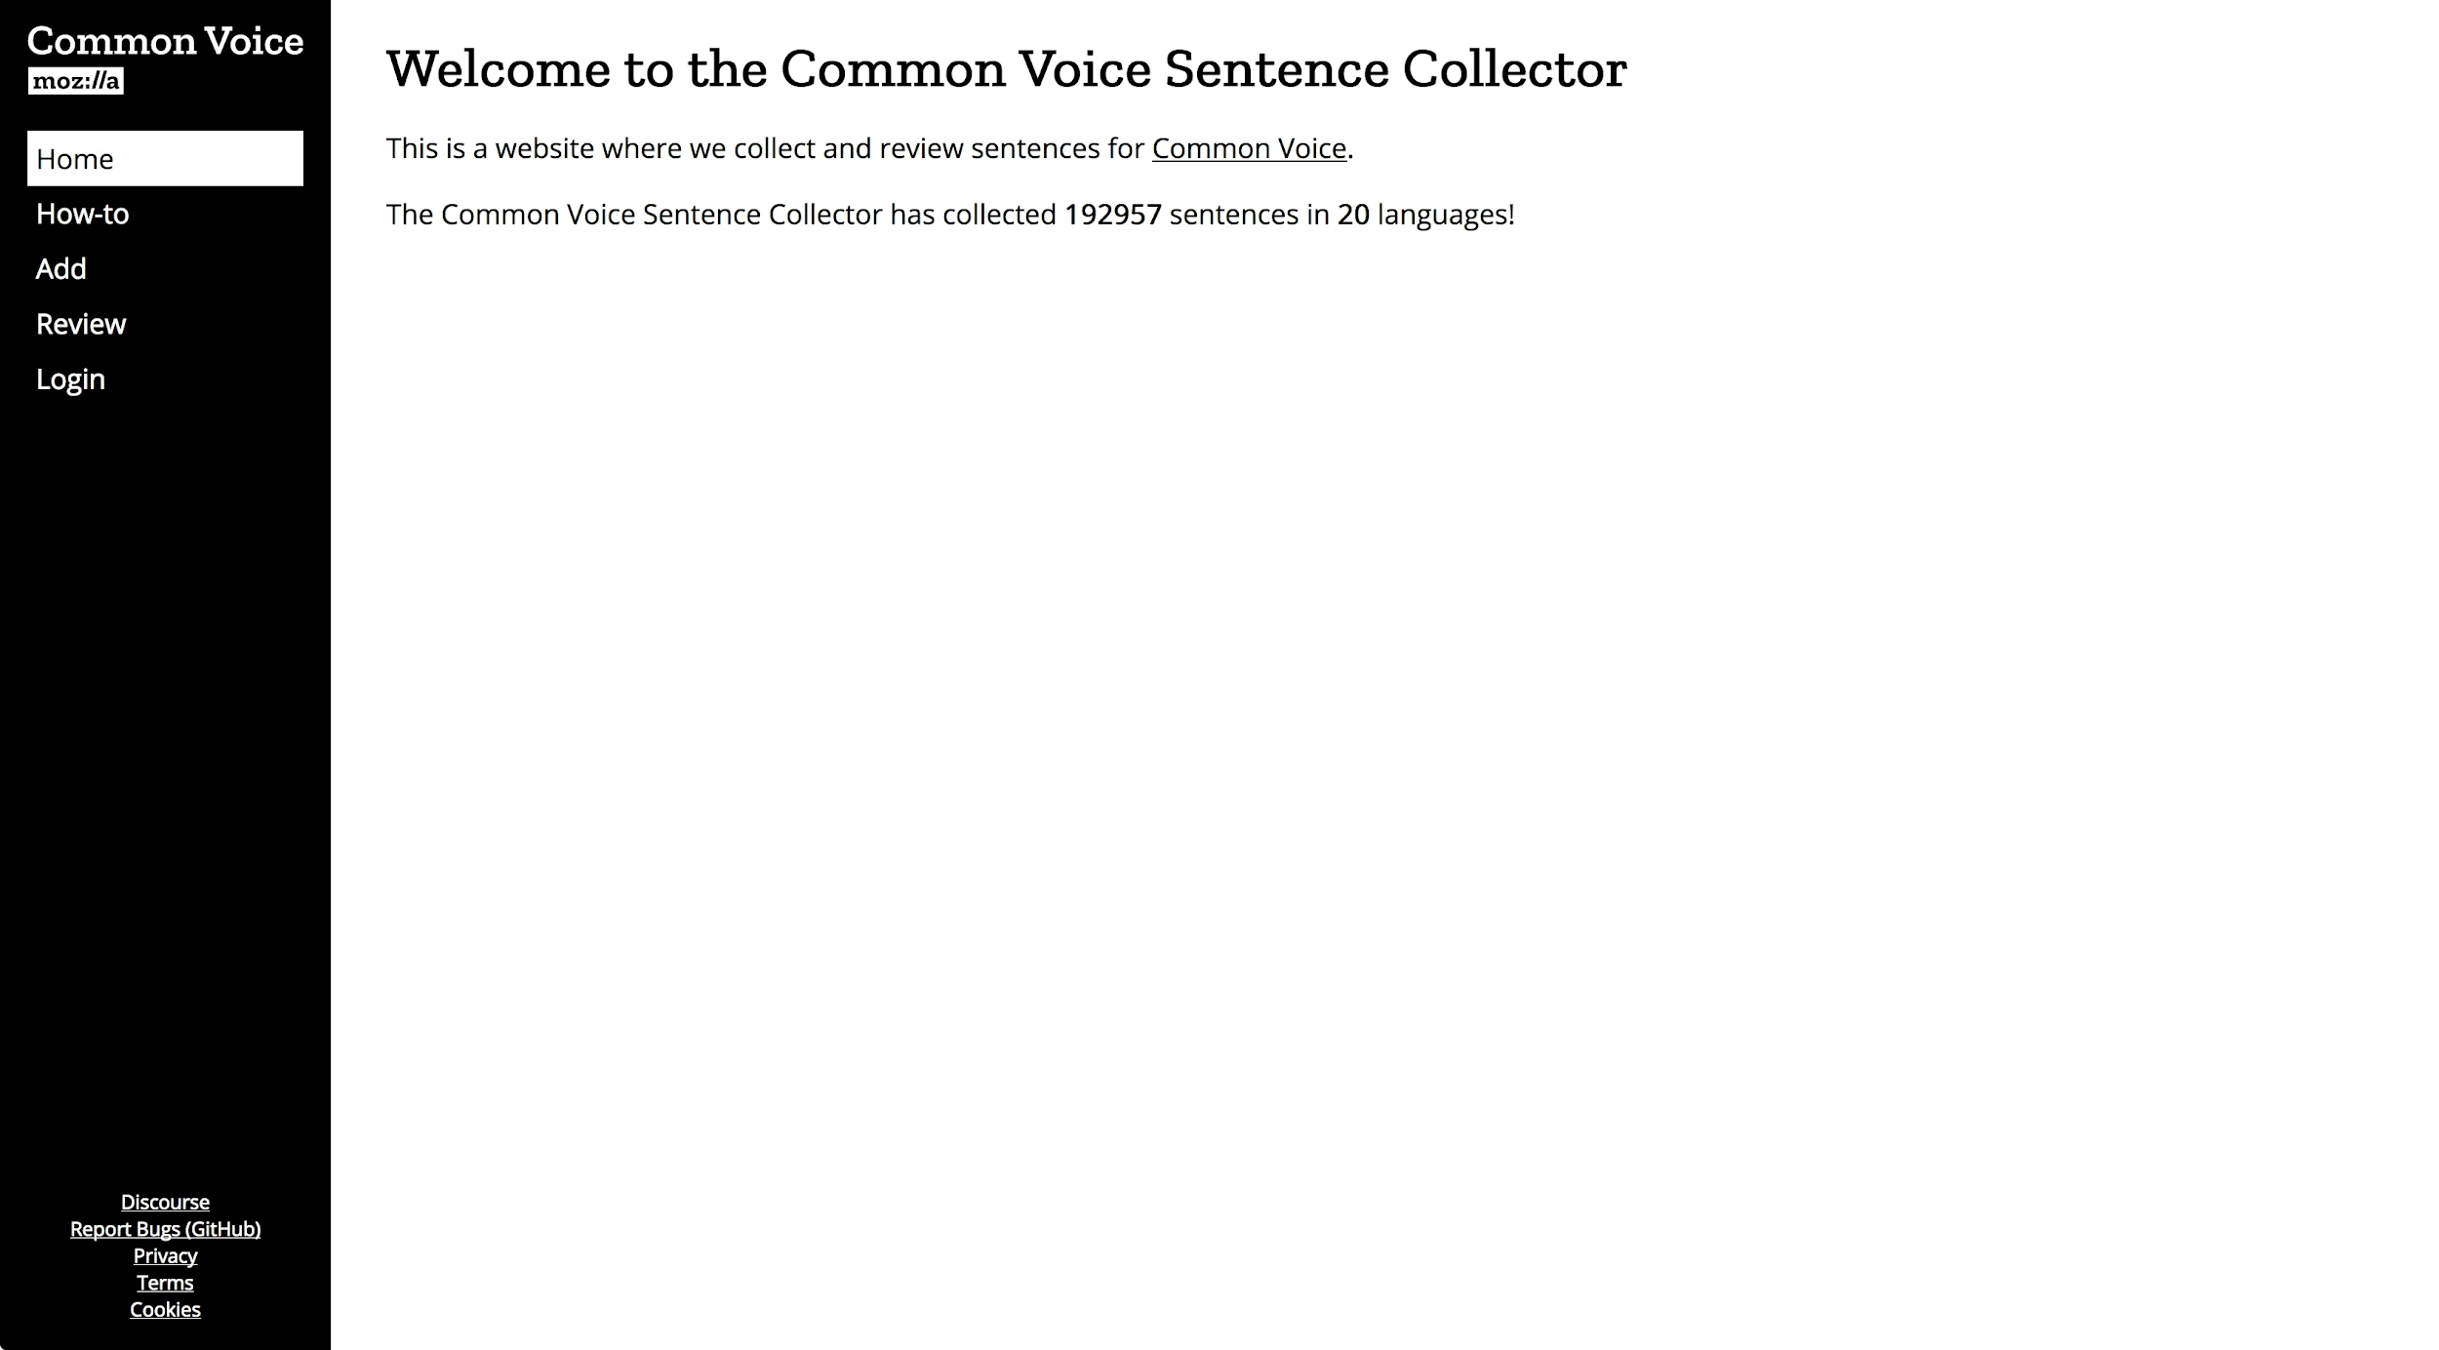
Sentence Collection: Homepage

Slide 40
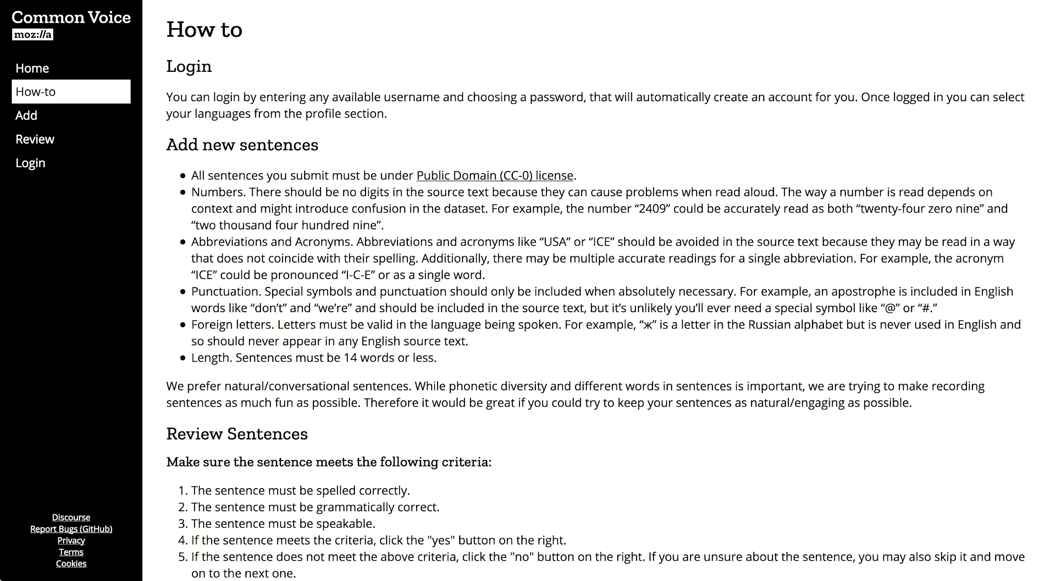
Sentence Collection: How To

Slide 41
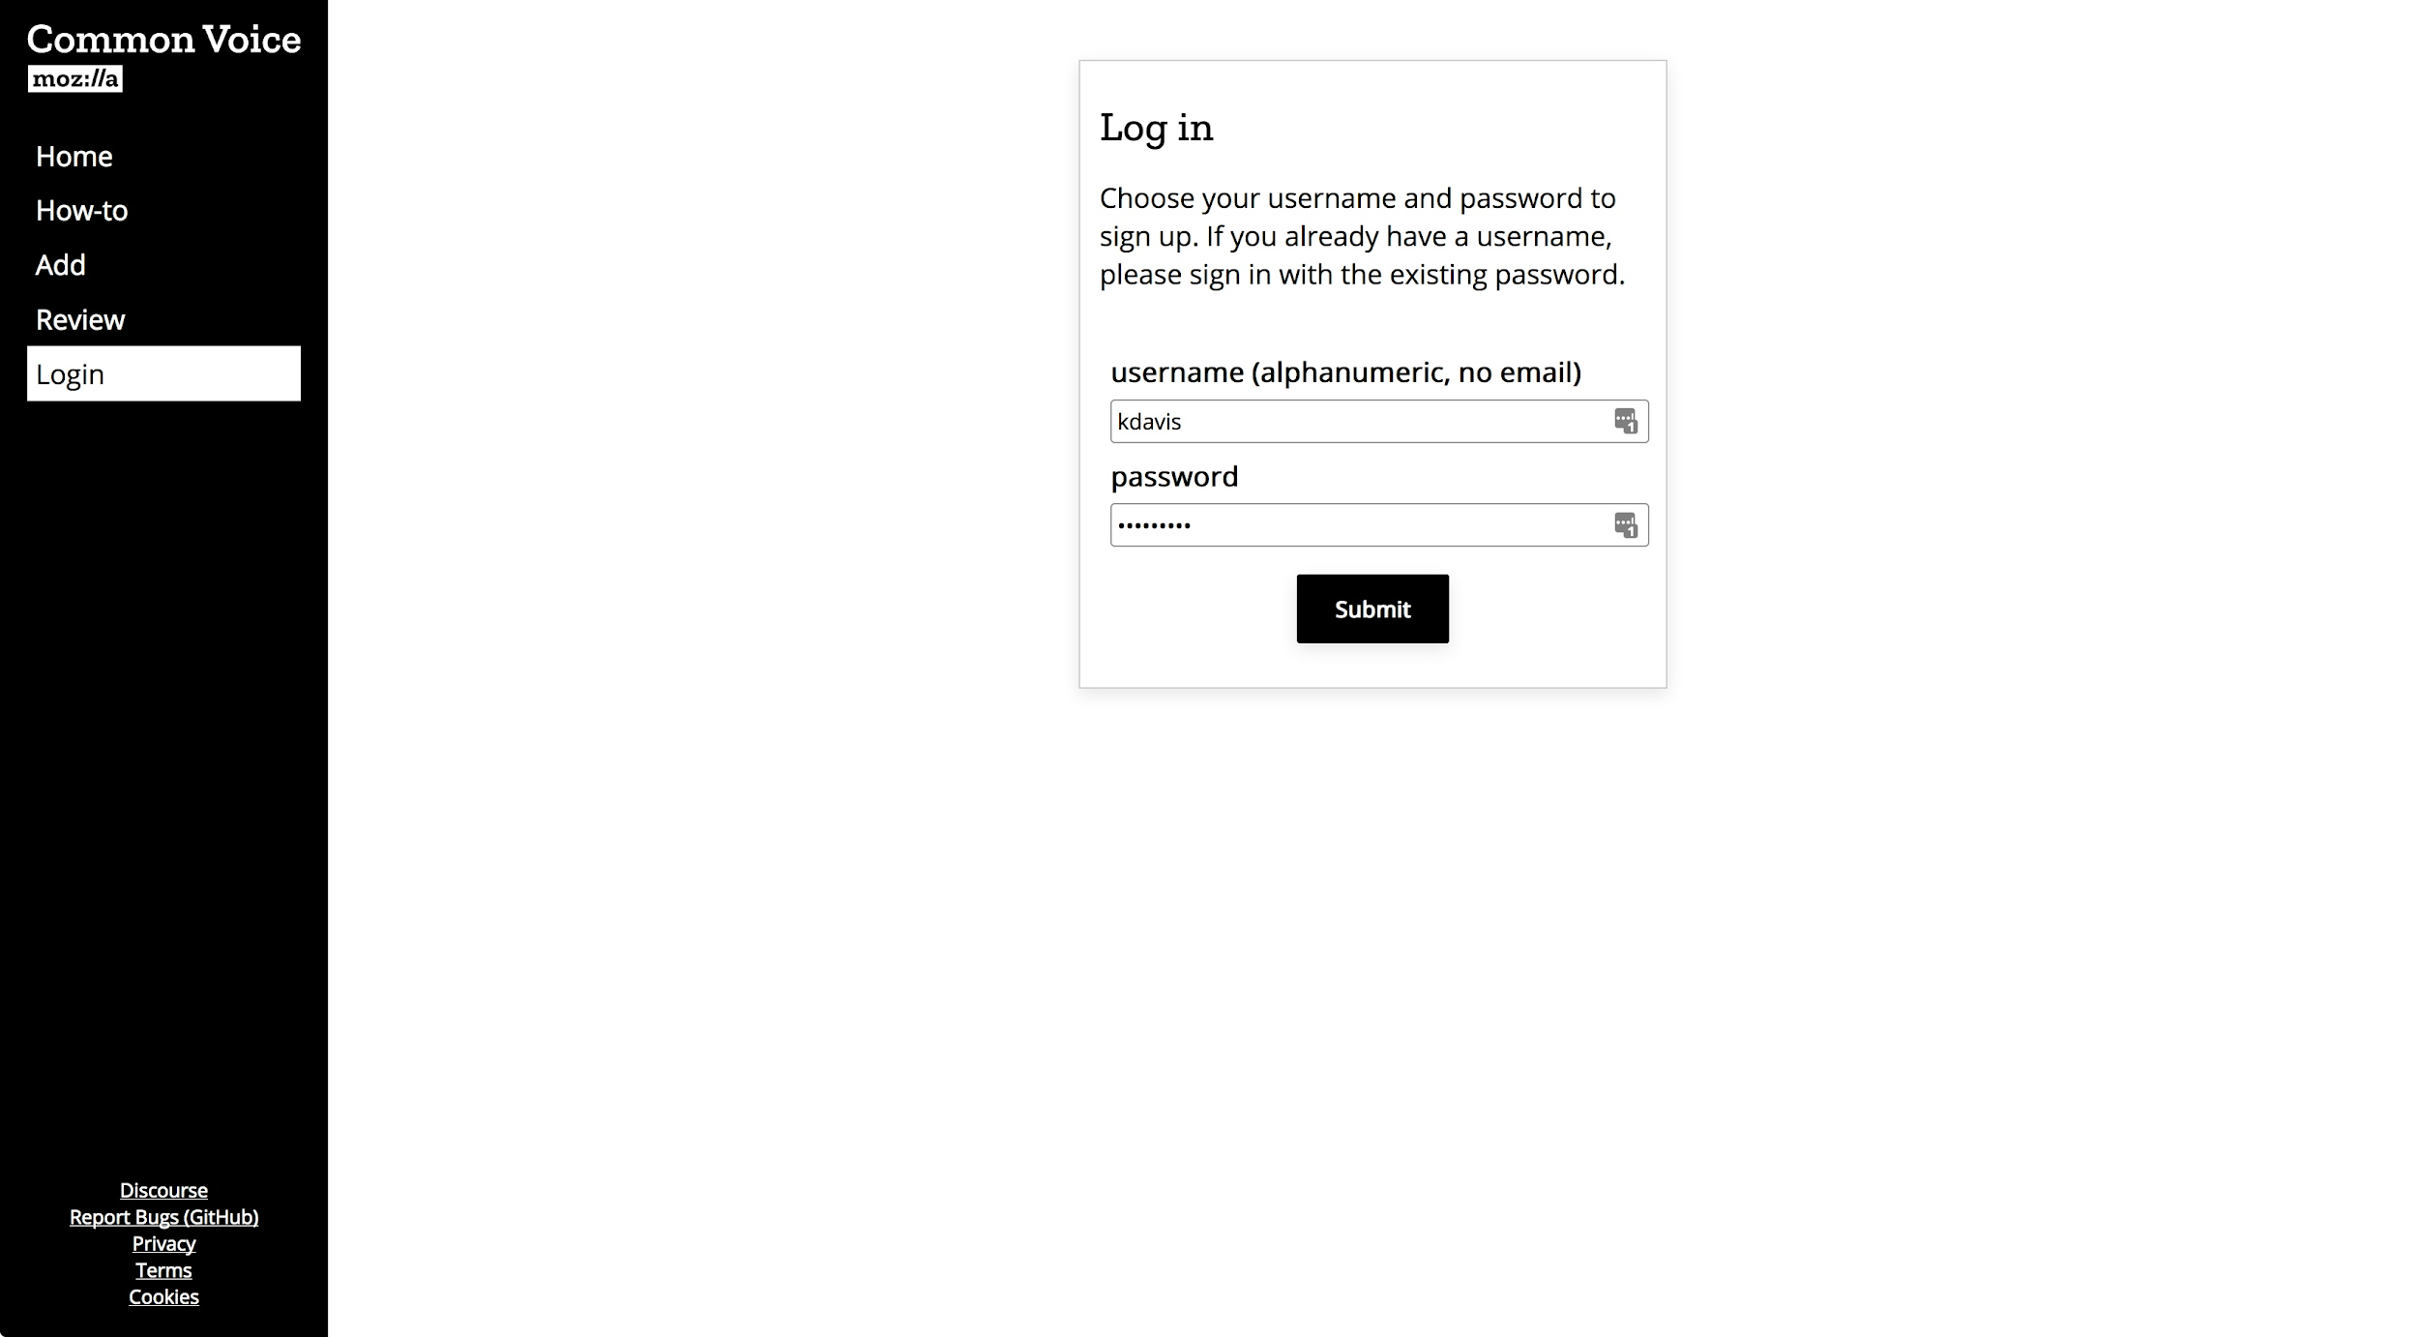
Sentence Collection: Login

Slide 42
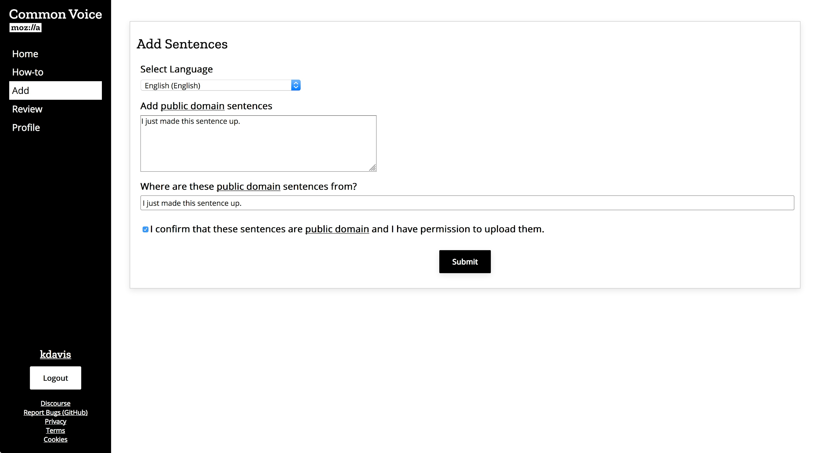
Sentence Collection: Add

Slide 43
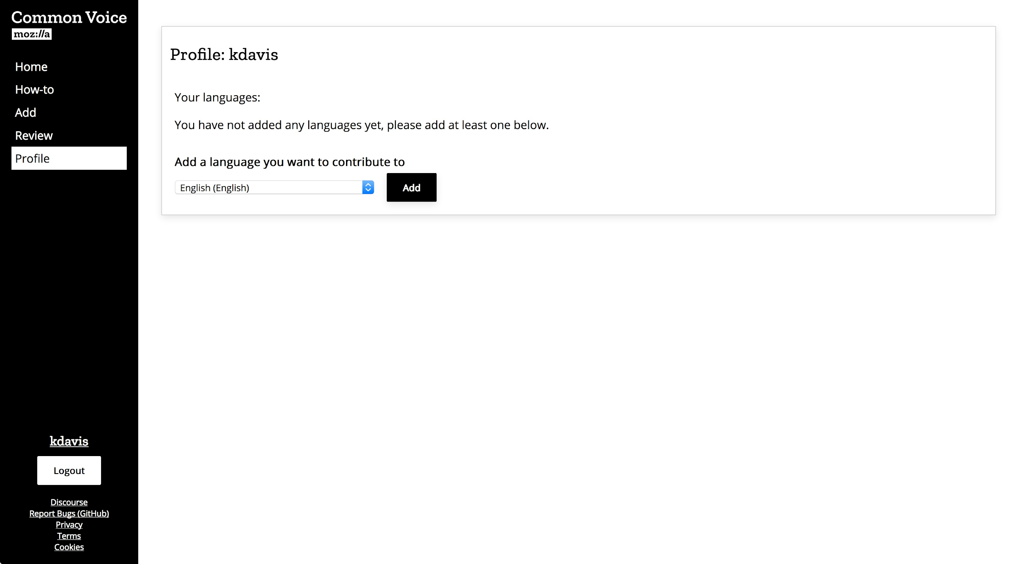
Sentence Collection: Profile

Slide 44
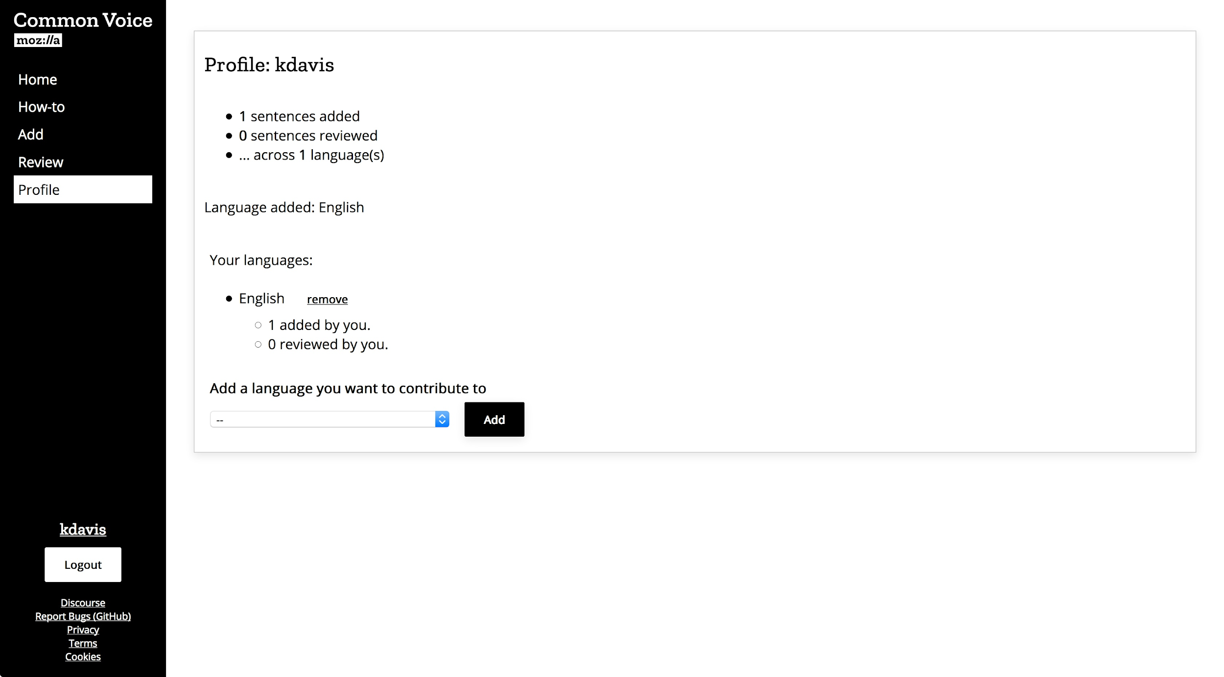
Sentence Collection: Profile

Slide 45
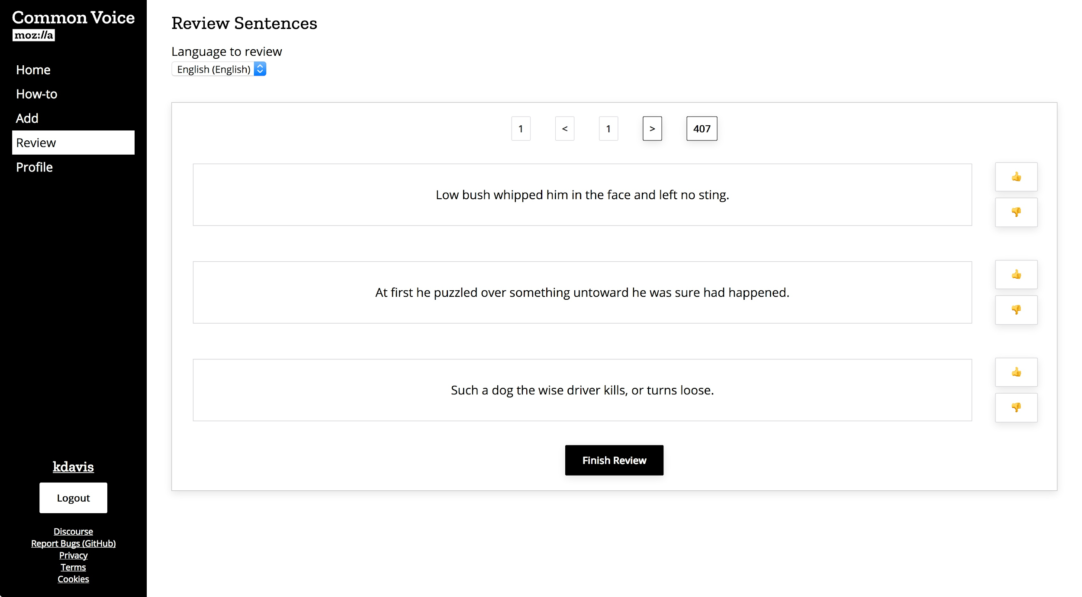
Sentence Collection: Review

Slide 46
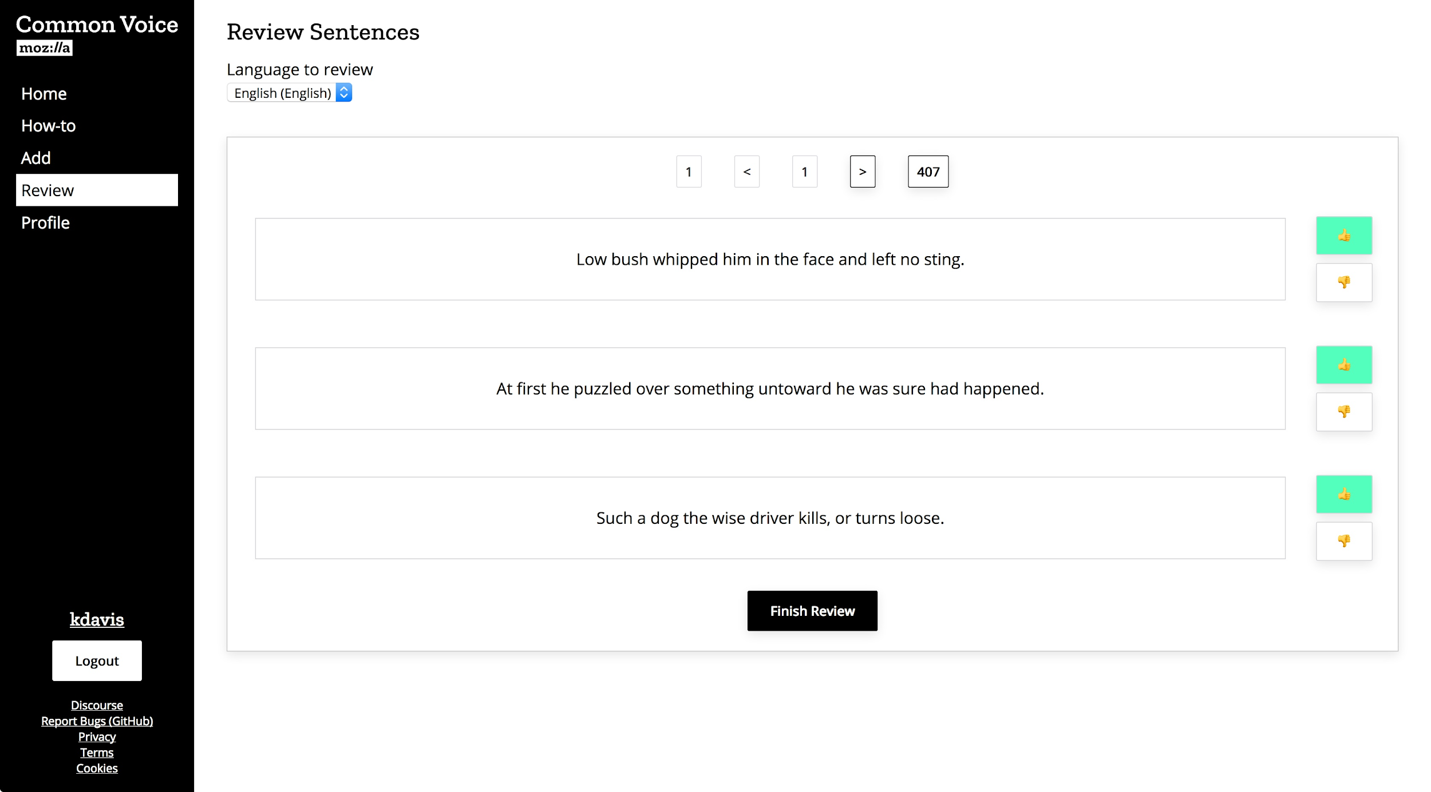
Sentence Collection: Review

Slide 47
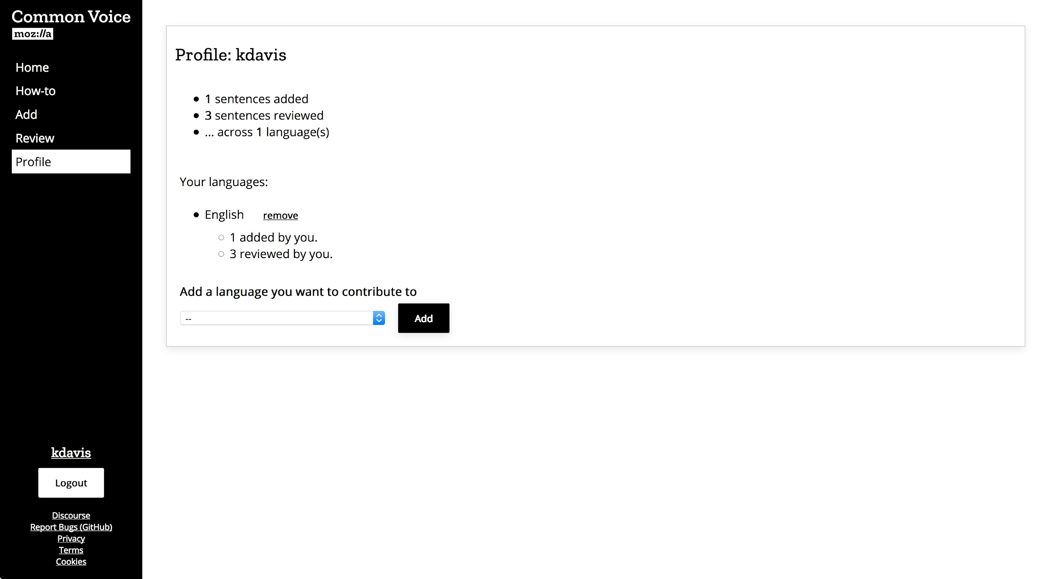
Sentence Collection: Profile

Slide 48
4 Future of Common Voice

Slide 49
4.1 Non-Corporate Partnerships

Slide 50


Non-Corporate Partnerships

Slide 51
4.2 Corporate Partnerships

Slide 52


Corporate Partnerships

Slide 53
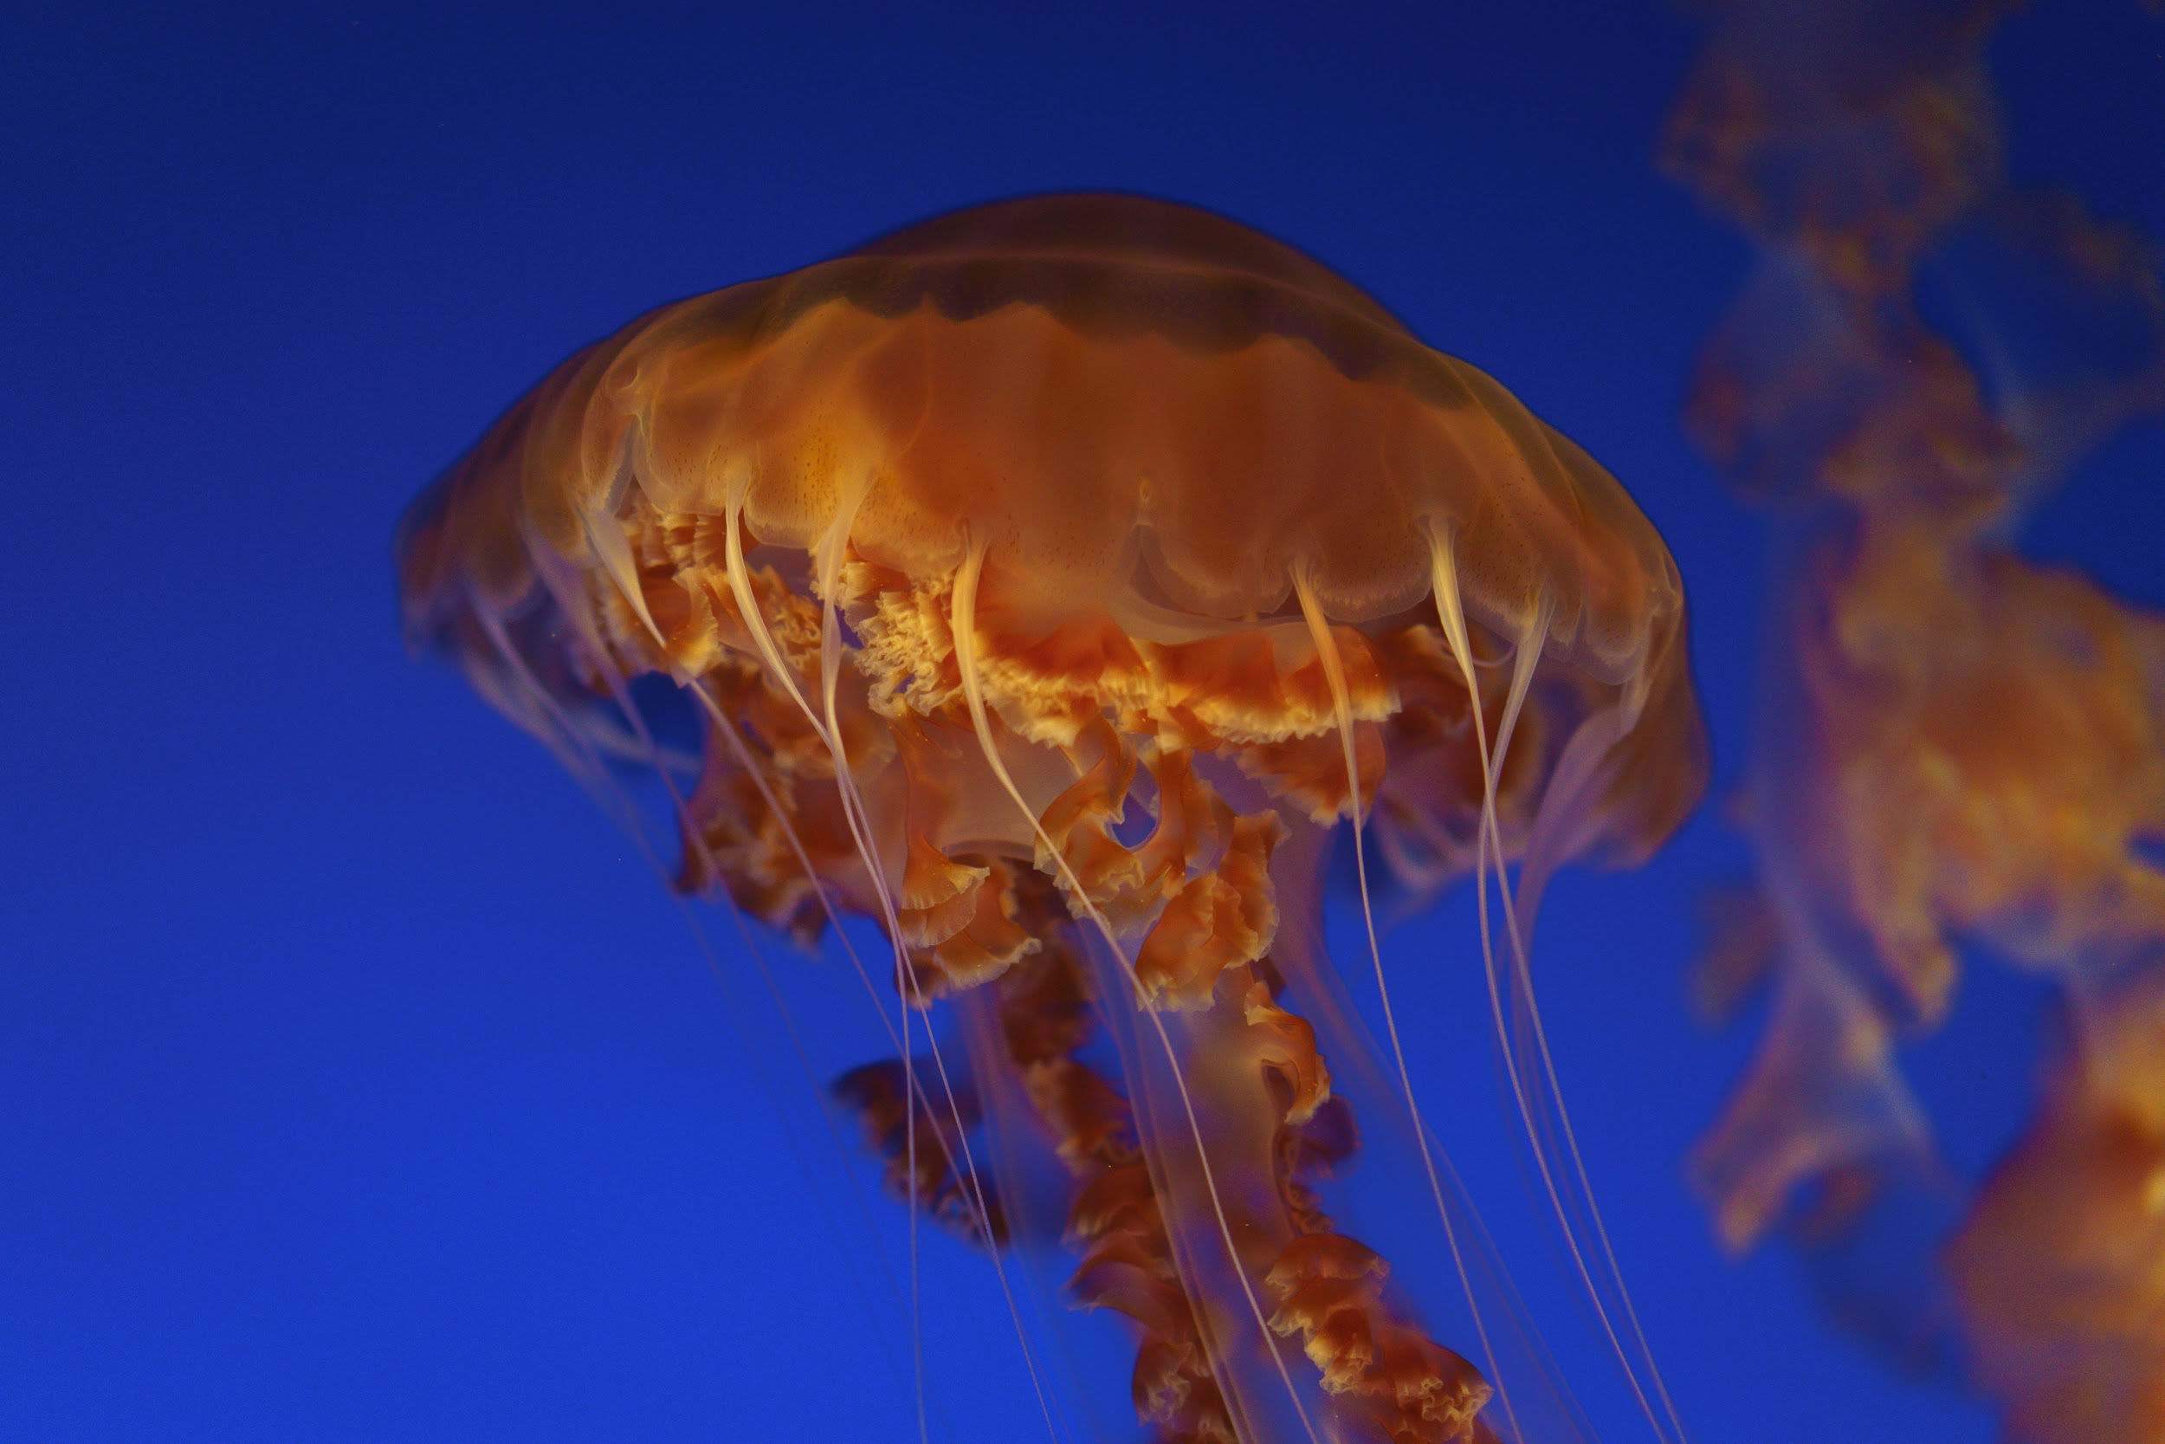
Murakoze...

